Slide 1
CIGRE Grid of the Future 12 October 2015 Chicago, Illinois, USA
Data Quality and Waveform Analytics
Jeffrey Wischkaemper, Ph. D.
Research Engineer
Department of Electrical and Computer Engineering
Texas A&M University
979-575-7213
jeffw@tamu.edu

Slide 2
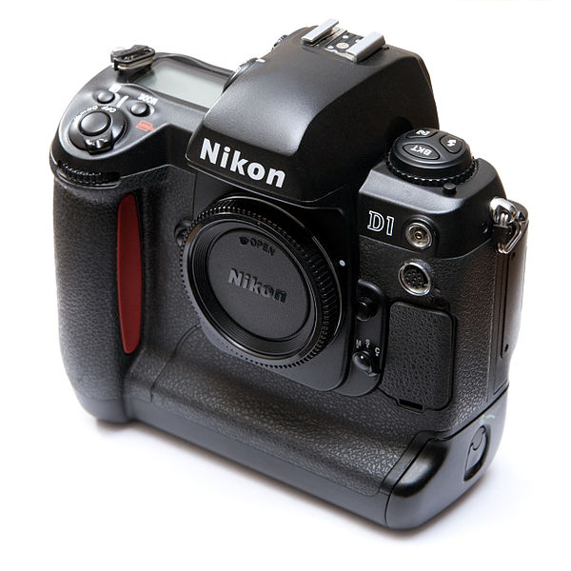
Signal Processing Analogy: Digital Cameras
The first wide-spread commercial digital camera was the Nikon D1, introduced in 1999.
By the standard of contemporary film cameras, it wasn’t very good.
Maximum resolution was 2.7 megapixels, and could shoot 4.5 frames per second.
But… if you were a newspaper, it was “good enough” to do what you were interested in – printing an 8x10 low-quality image on newsprint.

Slide 3
Signal Processing Analogy: Digital Cameras
As the technology progressed, the resolution of sensors (sample rate), increased dramatically.
Camera companies recognized they could sell more cameras by having a higher megapixel count than their competitor, even if they had worse image quality.
Professionals began to recognize that once a certain base level of resolution was met, other factors (dynamic range, noise performance, etc.) were much more important.

Slide 4
Signal Processing Analogy: Digital Cameras
Eventually in the professional and prosumer segment of the market, manufacturers backed out of the “megapixel wars” and began focusing on other aspects of signal quality.
So what does this have to do with waveform analytics? (This is a presentation about waveform analytics!)

Slide 5
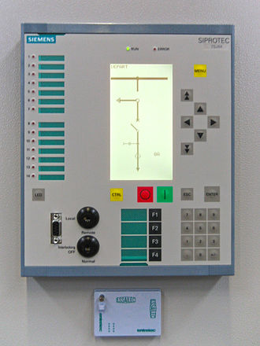
Signal Processing Analogy: Digital Cameras
In many ways, the D1 is similar to old, 4 sample-per-cycle relays.
Technology has improved dramatically, with some meters sampling at 6MHz (100,000 samples per cycle) for voltage channels!
Part of the problem we face as practitioners in the field of waveform analytics is that we are still in the middle of the “sample rate wars” – and we often are unaware, or unconcerned about critical aspects of signal quality.

Slide 6
Fundamental Principles of Waveform Analytics
Waveform analytics arises from the belief that power system waveform data contains useful information.
As we typically say in our presentations:
Feeder-level electrical waveforms represent feeder activity.
Sophisticated waveform analytics, applied to waveforms of sufficient fidelity, can detect failures, pre-failures, and other feeder events.
Question: “What do you mean by ‘sufficient’ fidelity (are you talking about needing 256 or 512 samples per cycle)?”

Slide 7
“Sufficient Fidelity” for Waveform Analytics
Analytics is a process that takes a large set of data and attempts to extract information, in order to produce knowledge.
Data is not information.
Information is not knowledge.
“Data” is a stream of numbers (“010011010101”)
“Information” is the complete set of characteristics encoded in a set of data (“maximum amplitude 514A in cycle 231 on phase C current”).
“Knowledge” is a representation of information that allows an action or decision to take place (“Phase C overcurrent fault occurred at 21:42, possibly repetitive, 514A, single-phase trip, reclosed once, no outage”).

Slide 8
“Sufficient Fidelity” for Waveform Analytics
“Sufficient fidelity” is about information, not about data.
Does recorded data (if I even record it!) contain enough information for me to determine “what happened”?
Example: If my current channel is overranged during an overcurrent fault, then I do not have enough information to determine (definitively) the fault current.
You can increase your data by an arbitrarily large factor (2x, 4x, 25,000x), and have no additional information.
The fidelity of a given platform is “sufficient” for a particular class of waveform analytics if and only if a final waveform recording contains enough information to distinctly characterize the event in question.

Slide 9
Sufficient for What?
Power system events have vastly different characteristics:
Low impedance faults contain mostly 60Hz frequency content, and can produce currents (at the terminals of the device) of almost 100 amperes.
High impedance faults contain higher frequency content, but can produce variations on the order of a few milliamps (at the terminals of the device).
Cable faults may produce incipient failure signatures that last only a half-cycle.
Downed conductors may need minutes of data to characterize securely.
Capacitors, load tap changers, transformers, vacuum switches, failing switchgear, lightning arrestors, etc.
Yet-to-be-characterized events

Slide 10
Sufficient for What?
How do we design a system that is capable of characterizing a broad variety of events recognizing that…
We cannot know…
what events we will observe (a priori).
what electrical characteristics they will have.
There are inherent design tradeoffs between…
sample rate
effective bits of resolution
memory usage
processing power
etc.

Slide 11
Sufficient Fidelity: Critical Factors
Sample Rate
Do I have enough frequency bandwidth to capture enough of the content I need? (“Do I have enough to distinguish this from that?”)
The power system itself can reduce the bandwidth required, particularly if I am measuring at a remote location (e.g. the substation).
Dynamic Range (bits of resolution)
What is the largest-magnitude signal I can measure, and what is the smallest variation I can detect?
What is the “noise floor” of my measuring equipment, and of the electrical circuit I am monitoring?

Slide 12
Sufficient Fidelity: Critical Factors
Recording length
Does my device allow me to record an entire event, particularly if that event spans several seconds (e.g. a series of breaker trips), or do I have “gaps”?
Memory / storage
Am I able to maintain a history of recordings on the device, or is there a chance I will lose important data if it is not retrieved in a timely fashion?
Processing power
Do I have the ability to push intelligence down to the waveform recorder level, or do I need to retrieve all data for processing at a central location?

Slide 13
Sufficient Fidelity: Critical Factors
Triggering sensitivity
Does my device allow me to capture very small disturbances, or is it designed to intentionally not record such events?
Do I have the ability to trigger on new quantities without doing a hardware modification?
Linearity and transient response
Are there characteristics of my device (analog or digital filtering, sensors, etc.) that may influence the spectral content or waveshape of the waveforms I record, and, if so, how will those affect the analytics I design and/or implement?

Slide 14
Sufficient Fidelity: Personal Thoughts
Sample rate, in most cases, should not be the most important consideration when selecting a particular device.
The biggest deficiency in most waveform recorders is the length of the recordings they generate.
Triggering sensitivity is very important.
It is critical to view the entire system – from failing apparatus to final waveform recording – in a holistic fashion (e.g. power system filtering effects, power system sensors, device sensors, device filtering, analog-to-digital conversion, device intelligence, etc.).

Slide 15
Questions?

Slide 16
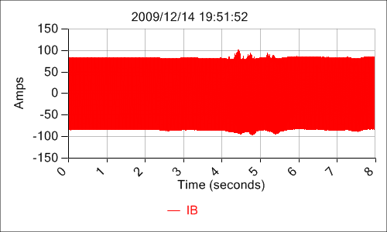
Waveform Analytics: Data Quality Intelligent Processing
Image Recognition Software
“Flower”
Waveform Analytics
“Arcing Clamp”
It is relatively easy for a human to look at the image above and say that the image is a flower. It is much harder, however, for a computer to do the same thing. Conventional waveform recorders produce waveforms, which must be analyzed by a human with specialized expertise if they are to be of any value. Waveform analytics, by contrast, automatically analyzes waveform recordings to produce actionable information for operators.

Slide 17
Waveform Analytics: Data Quality Sample Rate
These two pictures show the same flower, but one has significantly more resolution than the other. The increased resolution of the photo on the left makes it possible to see details that are not present in the right. In the same way, waveform analytics monitors need to record signals with higher sample rate than many conventional waveform recorders, enabling the detection of fine details not detectable in waveforms from those other devices.

Slide 18
Waveform Analytics: Data Quality Dynamic Range
These pictures show the same mountain scene, but the picture on the left has more bits of resolution, showing more levels of detail between the brightest and darkest parts of the image. In the same way, waveform analytics devices need to record signals with increased dynamic range compared to conventional waveform recorders, making it possible to detect small variations in waveforms which are missed by those other recording devices.

Slide 19
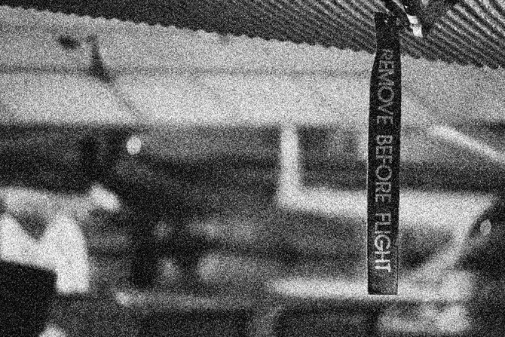
Waveform Analytics: Data Quality Noise
These pictures show the same scene, but the picture on the left has significantly less digital noise than the picture on the right. Waveform analytics devices need to record waveforms with very little noise, making it possible to detect details that are obscured by noise in recordings from some conventional waveform recorders.

Slide 20
Waveform Analytics: Data Quality Noise
These pictures also show the same flower, but the picture on the left has significantly less digital noise than the picture on the right. Waveform analytics devices need to record waveforms with very little noise, making it possible to detect details that are obscured by noise in recordings from some conventional waveform recorders.

Slide 21
Waveform Analytics: Data Quality Triggering Thresholds (details in the shadows)
Many waveform recording devices focus on a specific class of events. For example, fault recorders are designed to capture only overcurrent faults, while ignoring lower level events. Waveform analytics monitors, by contrast, need to record both very large transients (like overcurrent faults), and transients that fall well below the detection threshold for conventional waveform recorders. This allows analytics monitors to report actionable information for events that other systems ignore.

