Slide 1
CIGRE US National Committee
http : //www.cigre.org 2015 Grid of the Future Symposium
October 13, 2015 | Chicago , I L
Powering a new dawn in solar energy
Over 2 gigawatts of solar installed around the world
A Wave Shape Based Algorithm for Fast CT Saturation Detection
Abouzar Rahmati, PhD, PE, SMIEEE
Senior Scientist Manager

Slide 2
Main objectives
Discuss background and motivation
Common CT saturation detection algorithms
Proposed algorithm

Slide 3
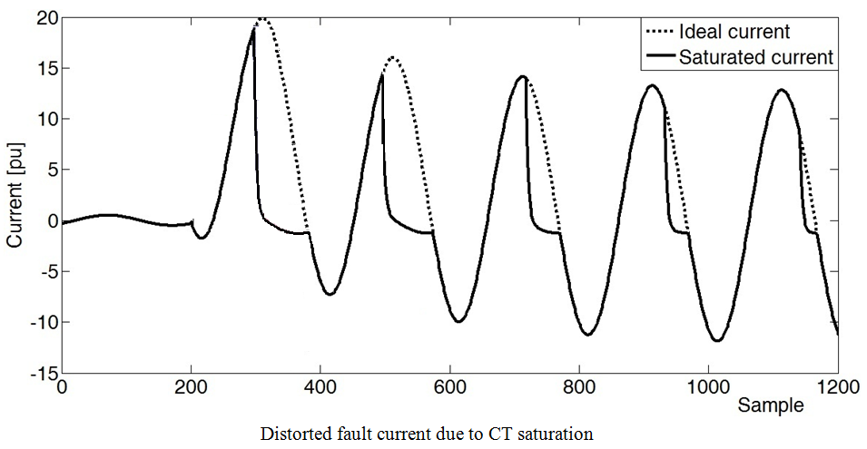
Current transformer saturation
Current transformers usually suffer from magnetic core saturation due to the large AC current amplitude and the existing decaying DC component in the fault current.
CT saturation issues:
- Distortion of secondary currents
- Inaccurate phasor measurement
- Miss-operation of the protective relays

Slide 4
CT Saturation Detection and Compensation
Waveform analysis based methods
Current signal harmonics
Current reconstruction using unsaturated samples
Artificial neural networks
Wavelet transform

Slide 5
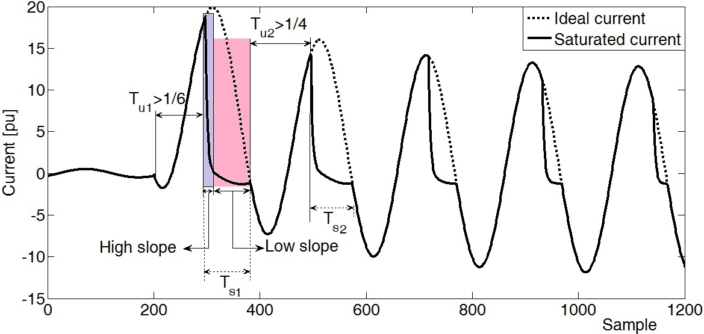
Proposed Algorithm
SEO wave-shape
Subtraction of the even and odd set samples (SEO) of the fault current is used for CT saturation detection.
Why Even and Odd set samples?
Saturation effect in the SEO wave-shape is much severe than the original signal.
Saturation in the SEO begins with high values and quickly decreases to zero.
Therefore, the CT saturation detection through the SEO signal is much more effective than the original fault current signal

Slide 6
Purely Sinusoidal Fault Current
$$i\left(t\right)=A_{1}\cos\left(2πft+φ_{1}\right)$$
$$i\left(n\right)=i^{e}\left(n\right)+i^{o}\left(n\right)$$
$$i^{e}\left(n\right)=A_{1}\cos\left(\frac{2π}{N}(2n)+φ_{1}\right)$$
$$i^{o}\left(n\right)=A_{1}\cos\left(\frac{2π}{N}(2n+1)+φ_{1}\right)$$
$$i^{eo}\left(n\right)={2A}_{1}\sin\left(\frac{π}{N}\right)\cos\left(\frac{2π}{N}\left(2n\right)+φ_{1}−\frac{π}{N}+\frac{π}{2}\right)$$
$$I\left(n\right)=\frac{I^{eo}\left(n\right)}{2sin (\frac{π}{N})}$$

Slide 7
Decaying DC Component
Removal Algorithm
$$i\left(n\right)=i_{ac}\left(n∆t\right)+i_{dc}\left(n∆t\right)$$
$$i_{ac}\left(n\right)=\sum_{h=1}^{H}{A_{h}\cos\left(2πf_{h}n∆t+φ_{h}\right)}$$
$${, i}_{dc}\left(n\right)=A_{dc}e^{−\frac{n∆t}{τ}}$$
$$i^{o}\left(n\right)−\cos\left(\frac{π}{N}\right)i^{eo}\left(n\right)−\cos\left(\frac{2π}{N}\right)i^{e}\left(n\right)=A_{o}\left(1+\cos\left(\frac{π}{N}\right)\right)e^{−\frac{∆T}{τ}}−\left(\cos\left(\frac{π}{N}\right)+\cos\left(\frac{2π}{N}\right)\right)e^{−\frac{∆T}{τ}\left(2n\right)}$$
$$d\left(n\right)={\left(1+\cos\left(\frac{π}{N}\right)\right)i}^{o}\left(n\right)−\left(\cos\left(\frac{π}{N}\right)+\cos\left(2\frac{π}{N}\right)\right)i^{e}\left(n\right)$$
$$\frac{d(n+1)}{d(n)}=e^{−\frac{2∆T}{τ}}$$

Slide 8
Decaying DC offset parameters
$$τ=\frac{−2∆T}{Ln\left[\frac{d\left(n+1\right)}{d\left(n\right)}\right]}$$
$$A_{o}={\left[\left(1+\cos\left(\frac{π}{N}\right)\right)e^{−\frac{∆T}{τ}}−\left(\cos\left(\frac{π}{N}\right)+\cos\left(\frac{2π}{N}\right)\right)e^{−\frac{∆T}{τ}\left(2n\right)}\right]}^{−1}d\left(n\right)$$
$$i_{dc}\left(n\right)=A_{o}e^{−\frac{∆T}{τ}n}$$
SEO signal extraction:
$$i_{dc}^{eo}\left(n\right)=A_{o}\left(1−e^{−\frac{∆T}{τ}}\right)e^{−\frac{∆T}{τ}\left(2n\right)}$$
$${ i}_{ac}\left(n\right)=i\left(n\right)−i_{dc}\left(n\right)$$
$$i_{ac}^{eo}\left(n\right)=i^{eo}\left(n\right)−i_{dc}^{eo}\left(n\right)$$

Slide 9
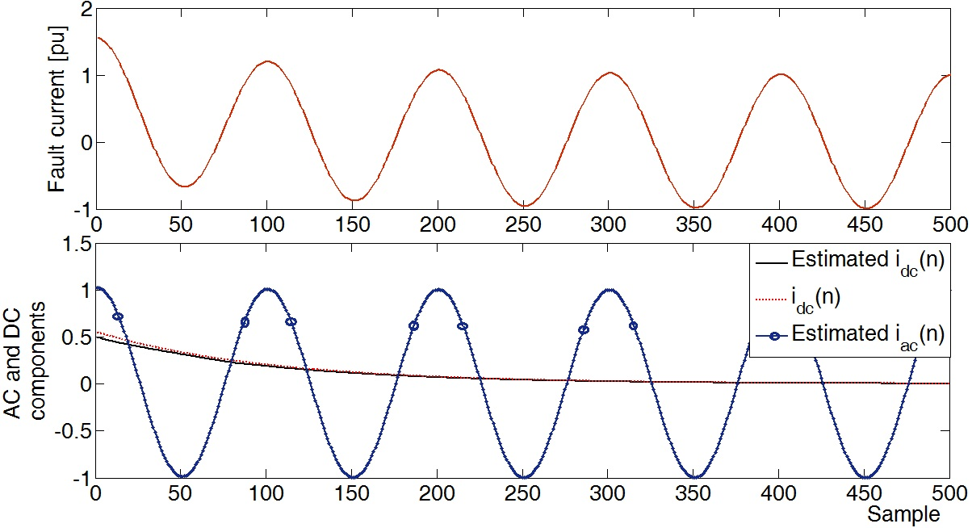
Example
$${i\left(n\right)=i}_{ac}\left(n\right)+i_{dc}\left(n\right)=1.5e^{−\frac{n∆T}{0.02}}+\cos\left(\frac{2π}{N}n\right)$$
$$E\left(n\right)=\frac{i_{dc}\left(n\right)−i_{dc}^{est}\left(n\right)}{i_{dc}\left(n\right)}×100\%$$

Slide 10
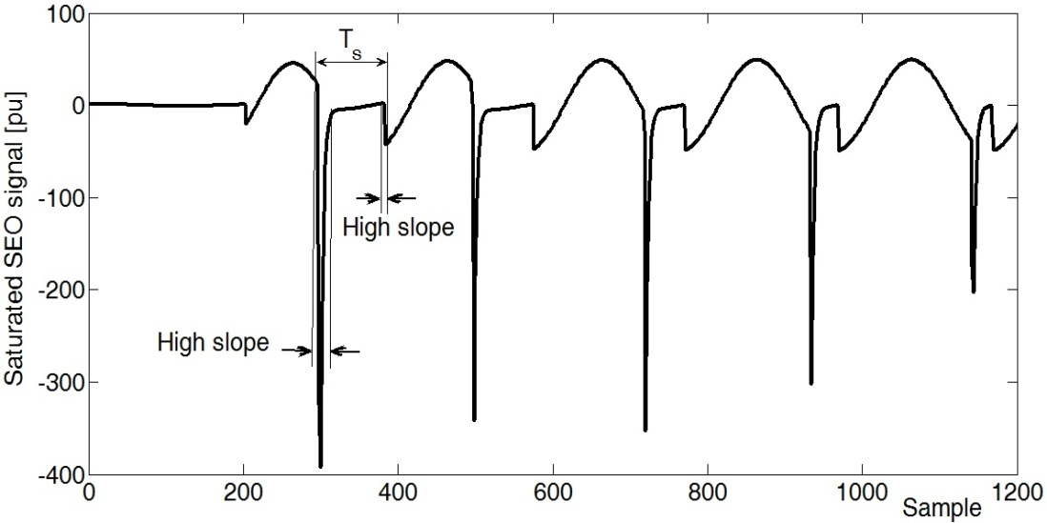
CT Saturation Detection
The secondary current contains two saturated and unsaturated distinguished portions.
Non-saturated period:
At least 1/6 cycle ($T_{u1}$) before the first saturated portion ($T_{S1}$), and about 1/4 cycle between any two successive saturated portions ($T_{u2}$).
Saturated period:$T_{S1}$
The saturated portion $(T_{S}$), begins with a high slope at the end of any $T_{ui}$ and then decreases to a low value.

Slide 11
Comparison of the original and SEO signals
Original signal includes 100% of the decaying DC initial amplitude: $A_{o}$
The decaying DC portion in the SEO signal is: $A_{o}(1−e^{−\frac{∆T}{τ}})$
$$\frac{i_{dc}^{est}\left(n\right)}{i_{dc}\left(n\right)}=1−e^{−\frac{∆T}{τ}}$$

Slide 12
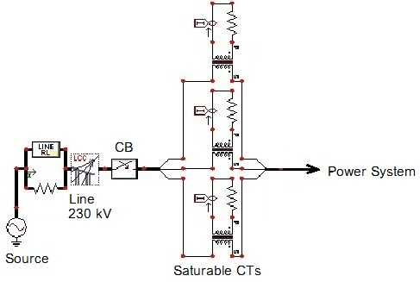
Results of Simulation
ATP/EMTP
230 kV, 50Hz power system model
- Transmission line, JMarti
- Circuit breaker
- Saturable CTs

Slide 13
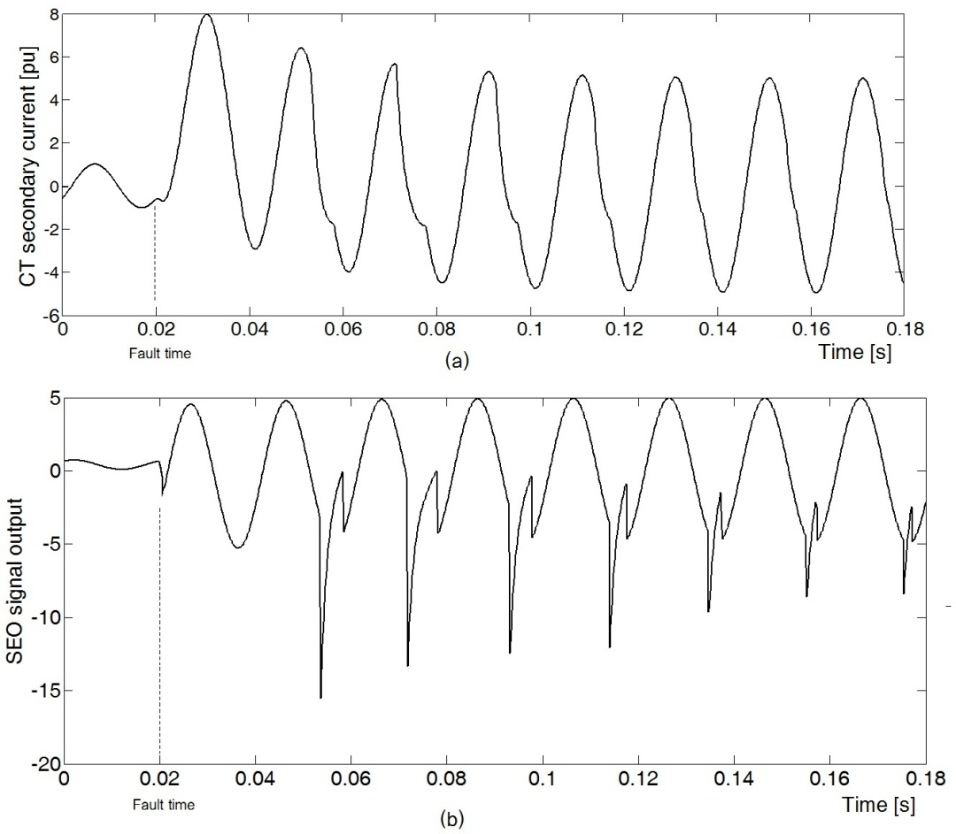
Results of Simulation
Slight CT Saturation
Slight Saturation, CT burden $=0.5 Ω$
Fault current in phase B due to a three phase fault at $t=0.02s$.
The SEO signal

Slide 14
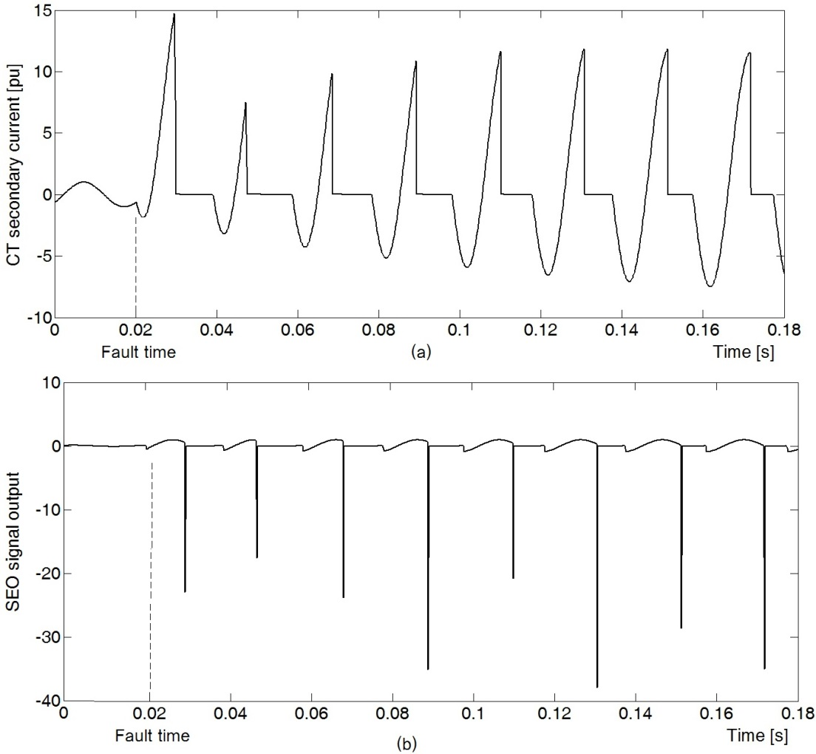
Results of Simulation
Deep CT Saturation
Deep Saturation with CT burden $=1 Ω$
SEO: The saturated portions ($T_{S}$) start with a sharp and high amplitude pulse
SEO: Is a sinusoidal signal without decaying DC offset, including some pulses in saturation conditions
All pulses are located at the beginning of CT saturation area during each cycle.
Therefore, using these pulses existing in the SEO signal, any CT saturation can be detected.

Slide 15
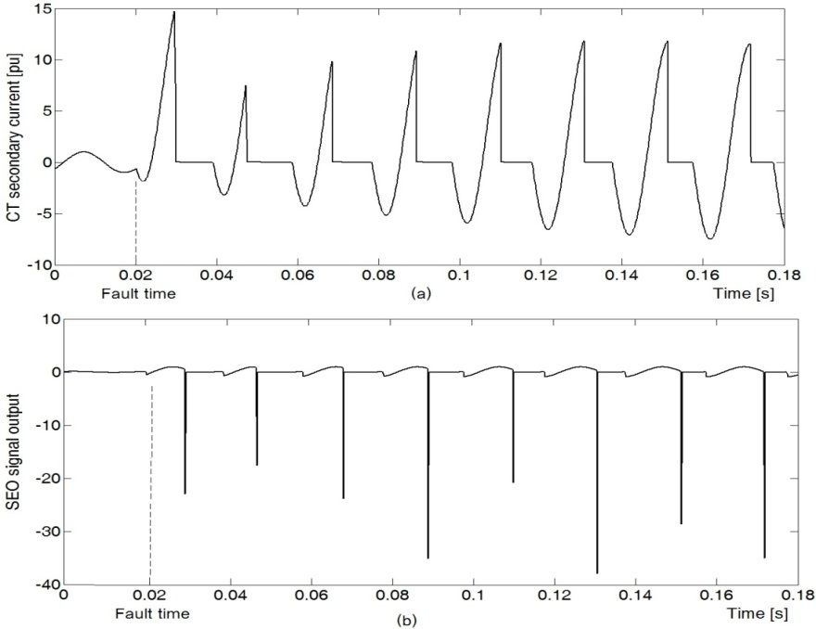
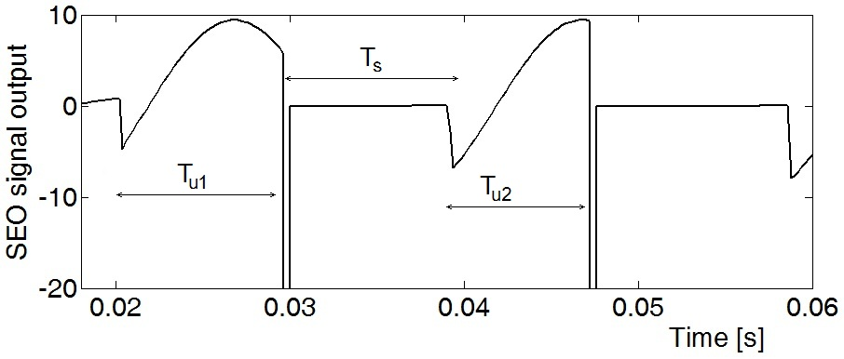
Results of Simulation
Deep CT Saturation
Expanded view of the SEO signal in deep CT saturation case

Slide 16
Conclusion
An efficient method for CT saturation detection was proposed.
The method is based on the subtracting the even and odd set samples (SEO).
The decaying DC offset is completely removed from the SEO signal.
Easy saturation area detection:
Saturation areas start with high amplitude pulses, which are easily detected.
This method is not affected by fault conditions, such as fault type, and decaying DC characteristics.
Is able to detect both deep and slight CT saturations.

Slide 17
Questions?
?
Abouzar Rahmati
SunEdison Inc.
arahmati@sunedison.com

