Slide 1

Geographic Information System (GIS) Based Evaluation of a Utility Service Territory for Public Purpose Microgrid Installations
Henry Pierce
Smart Grid & Technology
October 12th, 2015

Slide 2
outline
Overview of ComEd
Introduction to Microgrids
Holistic Evaluation of Service Territory
Proposed Microgrid Pilot Program
Additional Microgrid Efforts

Slide 3


ComEd, An Exelon Company
3.85 million electric customers
  in northern Illinois, including
  the City of Chicago
~6,000 Employees
Service Territory: 11,428 square miles
Peak Load: 23,753 MW (7/20/2011)
526,000 distribution transformers
65,000 circuit miles of primary distribution
53% overhead, 47% underground
5,800 circuit miles of transmission
Including 2nd largest underground network in the U.S.
1,083 substations
Chicago
Illinois

Slide 4
outline
Overview of ComEd
Introduction to Microgrids
Holistic Evaluation of Service Territory
Proposed Microgrid Pilot Program
Additional Microgrid Efforts

Slide 5
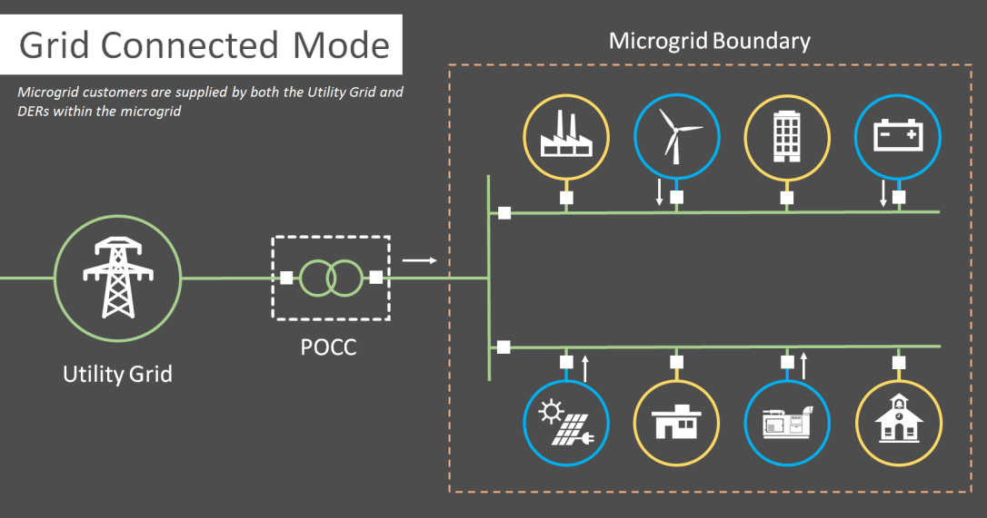
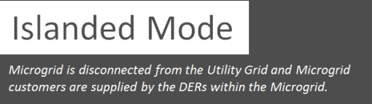
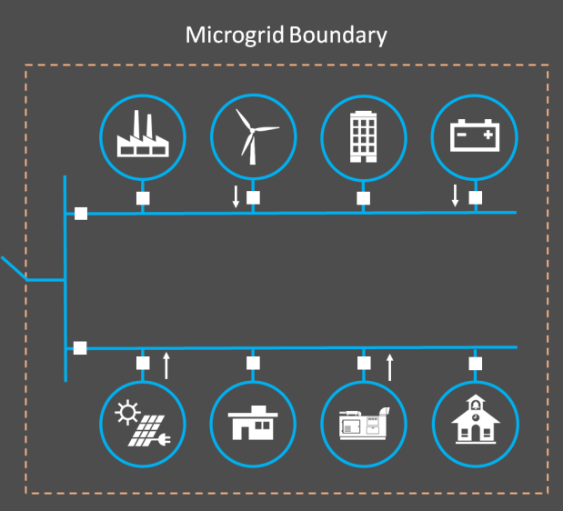

What Are MICROGRIDS?
The United States Department of Energy (DOE) defines Microgrids as localized power grids that can disconnect from the traditional utility grid to operate autonomously and help mitigate grid disturbances to strengthen grid resiliency.
Microgrids include local distributed generation (DG), which allows them to continue operating while the main grid is down and enables them to function as a resource for faster system response and recovery.
Microgrids support a flexible and efficient electric grid by enabling large-scale integration of renewable energy sources such as solar and wind as well as distributed energy resources – namely combined heat and power, energy storage, and demand response.

Slide 6
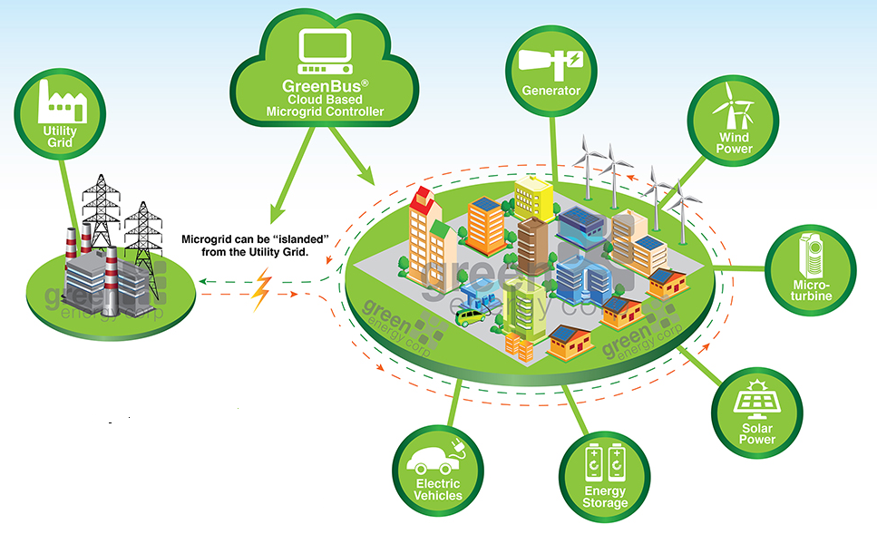
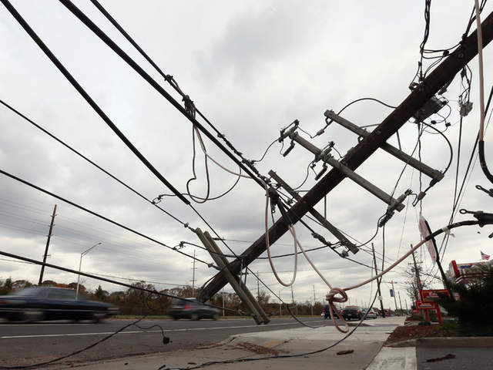
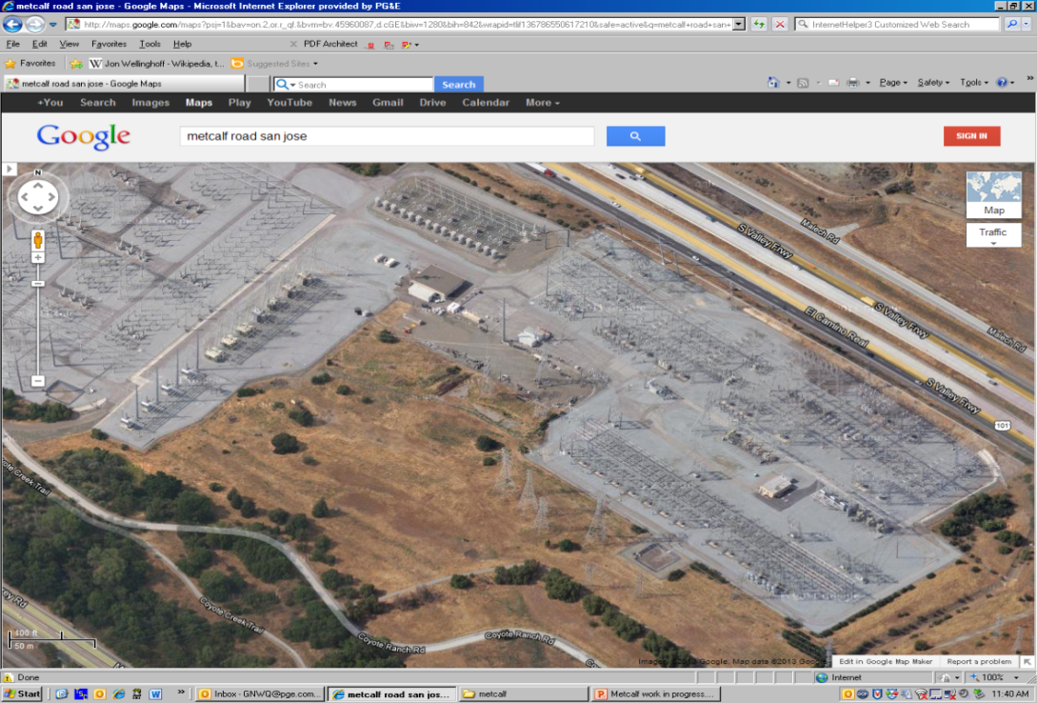
Drivers of Microgrids
Increasing frequency of severe weather events and rising concerns over security.
Growth of digital technology and Internet of Things placing high priority on power reliability and quality.
Reduction in CO2 and other harmful emissions by relying on sustainable generation sources.
Improved system efficiency, deferred capacity investments and sale of excess generation.
Environmental Benefits - Source: Green Corp
Superstorm Sandy Aftermath
Sniper attack on PG&E’s Metcalf substation

Slide 7

Value Proposition for microgrids
Microgrids provide numerous wide reaching benefits
Resiliency, Security & Safety:
Improved physical and cyber security
Increased resiliency through localized system operations
Economic:
Greater system efficiency
Deferred or avoided capacity investments
Create new jobs
Reliability & Power Quality:
Reduced power interruptions
Shorter outages
Enhanced power quality
Environmental:
Reduced CO2 and other harmful emissions
Increases sustainable generation resources
Reduced system losses

Slide 8
outline
Overview of ComEd
Introduction to Microgrids
Holistic Evaluation of Service Territory
Proposed Microgrid Pilot Program
Additional Microgrid Efforts

Slide 9
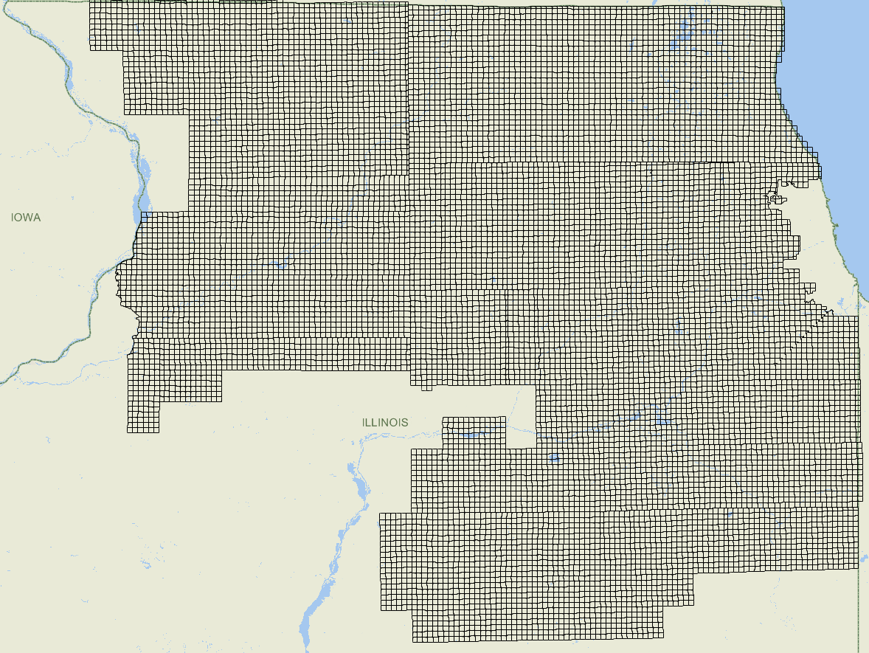
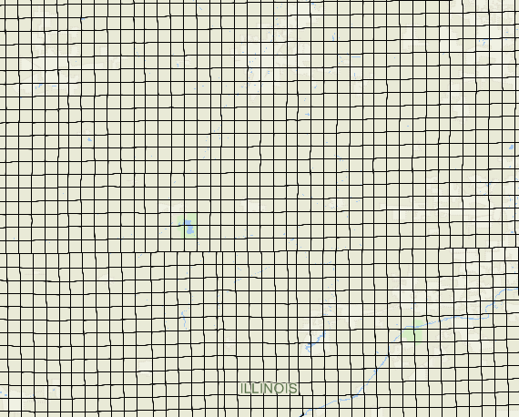
Holistic Evaluation of Service Territory
ComEd utilized a holistic data driven approach to evaluate its entire service territory for microgrid pilot installation locations. The approach considered three key drivers:
  Power delivery infrastructure scope
  Critical infrastructure
  Input from external stakeholders
The approach divided the service territory into one-mile by one-mile sections outside the city of Chicago and into half-mile by half-mile sections inside the city of Chicago.
In the selection process, ComEd leveraged its partnerships with governmental organizations including the Department of Energy (DOE), Department of Homeland Security (DHS), Illinois Emergency Management Agency (IEMA), and City of Chicago Office of Emergency Management and Communications (OEMC).

Slide 10

Critical Infrastructure Metric
Identifies customers and facilities most critical for continued operations of society during an extreme event causing disturbances to the traditional power delivery infrastructure
Critical infrastructure was scored base on its level of significance – national, regional or local
The critical customer information was collected through discussions with external organizations that are responsible for emergency management and national security
Healthcare
Communication
Water Delivery
Communities
Evacuation Centers
Transportation
Certain Federal Facilities
Correctional Facilities
Local Government

Slide 11

Reliability Metric
Based off of the five-year average System Average Interruption Duration Index (SAIDI), which is measured in minutes
Combination of:
  System Average Interruption Frequency Index (SAIFI)
  Customer Average Interruption Duration Index (CAIDI)
Individual circuit equipment outage information was linked to sections
This provides an overall representation of system reliability

Slide 12

Capacity Metric
System configurability and future growth were considered through the multifaceted capacity metric
Load at Risk – most influential information relating the power delivery system to supply resiliency and security
  Load that is in danger of not being served in the case of a substation transformer failure
  N-1 conditions
  Load that is fed by
Feeder Loading – relates each feeder’s unique capacity limits based on projections for the average loading and overload for three years
Terminal Loading – Based on projected average and peak substation terminal loading for three years
Capacity Metric = (Load at Risk)*X1 + (Feeder Loading)*X2 + (Terminal Loading)*X3

Slide 13

Substation Metric
Based on consequence and probability of failure or substation infrastructure in place to support each subsection
Consequence of Failure:
  Number of customers served coupled with the deployment of distribution automation
  The ability to restore customers from alternate feeds
  Reliability information for the customers served
Probability of Failure:
  Bus Tie Health Scores
  Circuit Breakers Health Scores
  Transformer Health Scores
  Historic Bus Lockouts over the last 10 years
  Performance of the substation bus-tie equipment
Substation Metric =
(Consequence of Failure)*(Probability of Failure)

Slide 14

Overall resiliency Metric
All of the aforementioned factors contributed to the overall resiliency metrics along with a few other factors related to system performance and customer satisfaction
Each section received a score based on a weighted summation of all the metrics
Resiliency Metric = A₁*(Critical Customer Metric) + A₂*(Reliability Metric) + A₃*(Capacity Metric) + A₄*(Substation Metric

Slide 15
outline
Overview of ComEd
Introduction to Microgrids
Holistic Evaluation of Service Territory
Proposed Microgrid Pilot Program
Additional Microgrid Efforts

Slide 16
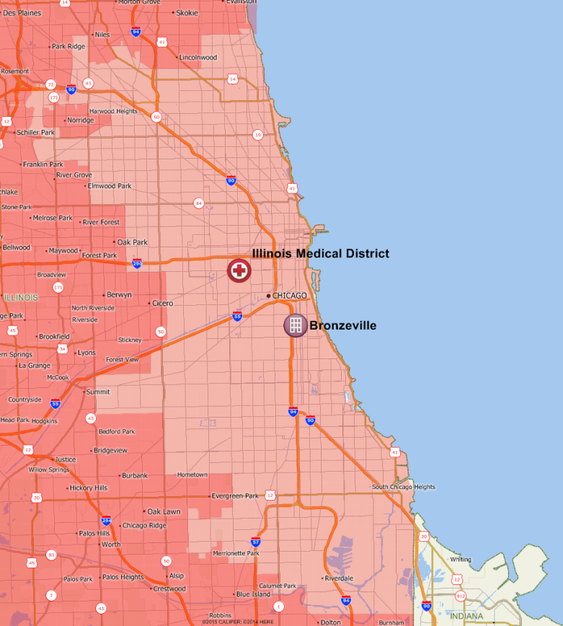
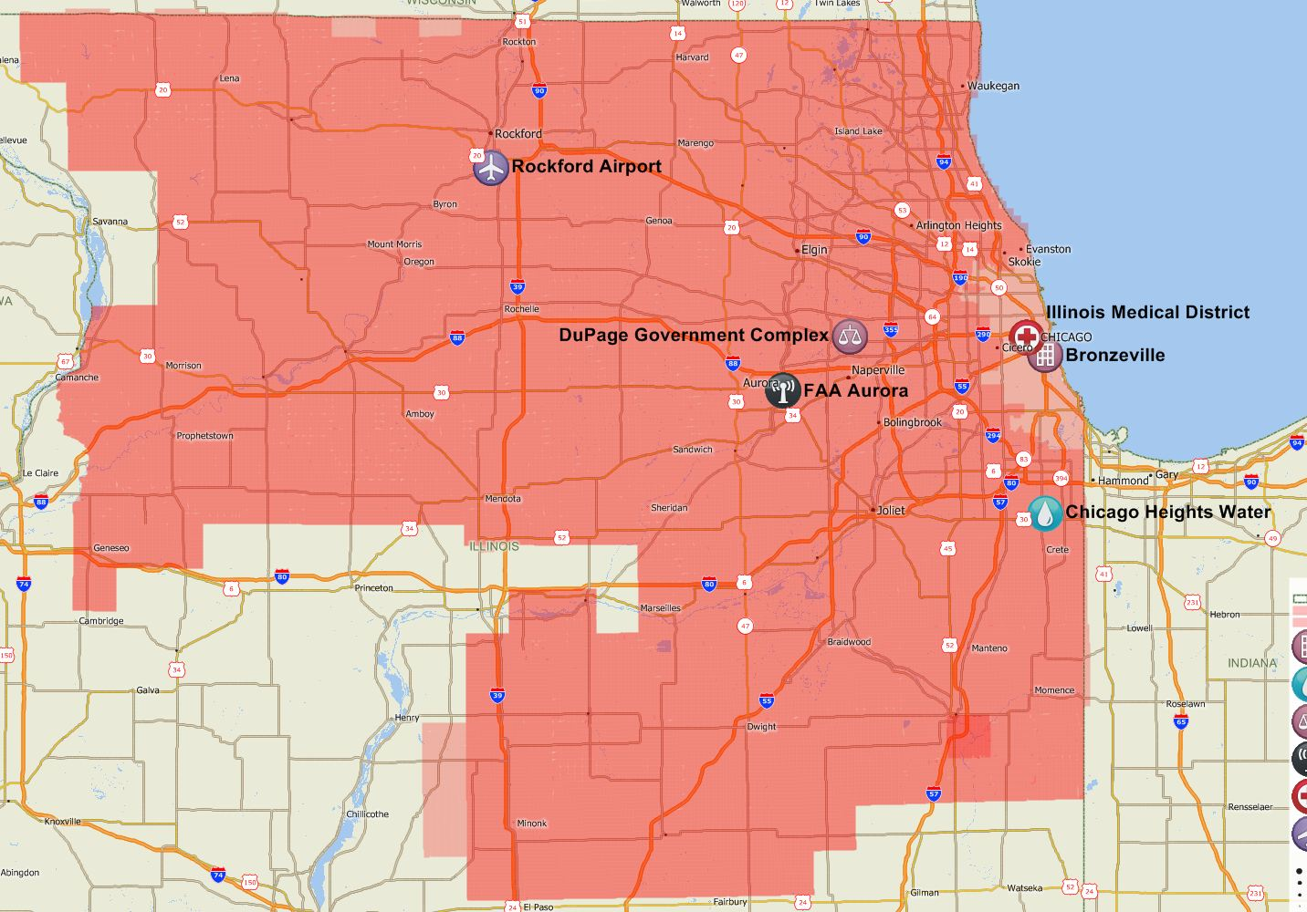
Proposed Microgrid Pilot Program
In March of 2015, ComEd proposed a bill to the Illinois General Assembly which included a microgrid pilot program. The pilot program would allow ComEd to invest up to $300 in six microgrid locations
Bronzeville Community in Chicago
Illinois Medical District
Chicago Heights Water Services
Rockford International Airport
FAA Facility in Aurora
DuPage Government Complex
15

Slide 17
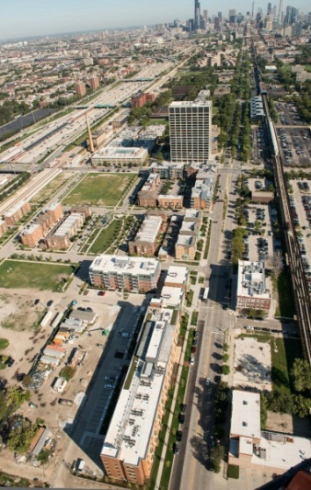
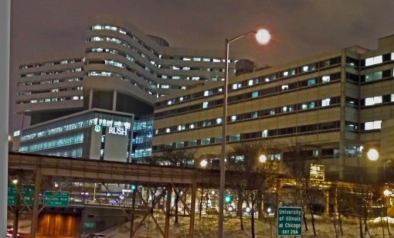

Proposed Locations in SB 1879
Bronzeville Community Microgrid
Provides a representative cross-section of different customers within the City of Chicago in what is referred to as a “community microgrid” model
Includes a diverse mixture of facilities and critical loads: Chicago Police Headquarters, health care facilities for senior citizens, educational facilities, and private residences.
Introduces an opportunity to cluster the proposed microgrid with an existing privately owned microgrid at the Illinois Institute of Technology (IIT).
  This technology will then be deployed at other locations such as the Illinois Medical District
Illinois Medical District (IMD) Microgrid
Cluster of major hospitals and other critical infrastructure within a small footprint in the City of Chicago.
Supports the major health care facilities that provide services to a large number of people within ComEd service territory.
Chicago Heights Water Microgrid
Public purpose microgrid providing resilient supply to water pumping and treatment facilities in a small footprint along Thorn Creek in the City of Chicago Heights.
Supports water infrastructure for southern suburbs of Chicago including Chicago Heights, Ford Heights, Homewood, Park Forest, South Chicago Heights, Steger and Crete.

Slide 18


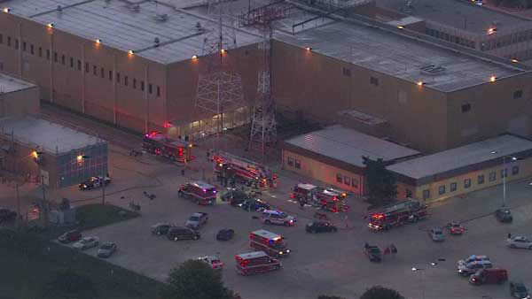
Proposed Locations in SB 1879
DuPage County Complex
The complex includes administrative buildings, youth home, county health department, judicial building, sheriff department, highway department, county jail, and emergency management offices within a small footprint ideal for a microgrid installation.
Provides resilient power supply to support critical operations of a major county within the ComEd service territory.
Rockford International Airport
The proposed microgrid would support critical facilities for cargo and transportation infrastructures within ComEd’s service territory.
Rockford airport is a major hub for air cargo and disruption to its operations could have an impact on the economy in Northern Illinois.
FAA Aurora
The facility has a major impact on the air traffic in North America – a recent fire event at the facility disrupted air traffic in the US for several weeks.
Potential opportunity to extend the microgrid to the neighboring Provena Hospital, schools, health department and blood center.

Slide 19
outline
Overview of ComEd
Introduction to Microgrids
Holistic Evaluation of Service Territory
Proposed Microgrid Pilot Program
Additional Microgrid Efforts

Slide 20


Additional Microgrid Efforts – Microgrid Controller
The DOE awarded approximately $1.2 million to ComEd and it’s partners to develop and test a commercial-grade microgrid controller capable of managing two or more interconnected microgrids
Supporting IEEE 2030.7 microgrid controller standard development, IEEE/PES microgrid taskforce and Quadrennial Energy Review
This project would be the first large-scale clustered microgrid in the world.

Slide 21



