Slide 1
Lessons Learned Implementing an IEC 61850-based Microgrid Power-Management System
October 12, 2015
Presented by: Jared Mraz, P.E.

Slide 2
Introduction
Fuel refinery in Salt Lake City, Utah
Reliability improvement projects started in 2012
New main substation
New medium-voltage distribution infrastructure
New microprocessor-based relays installed
Dedicated Protection and SCADA network installed
Existing loads cut-over from aging substations to new feeds

Slide 3
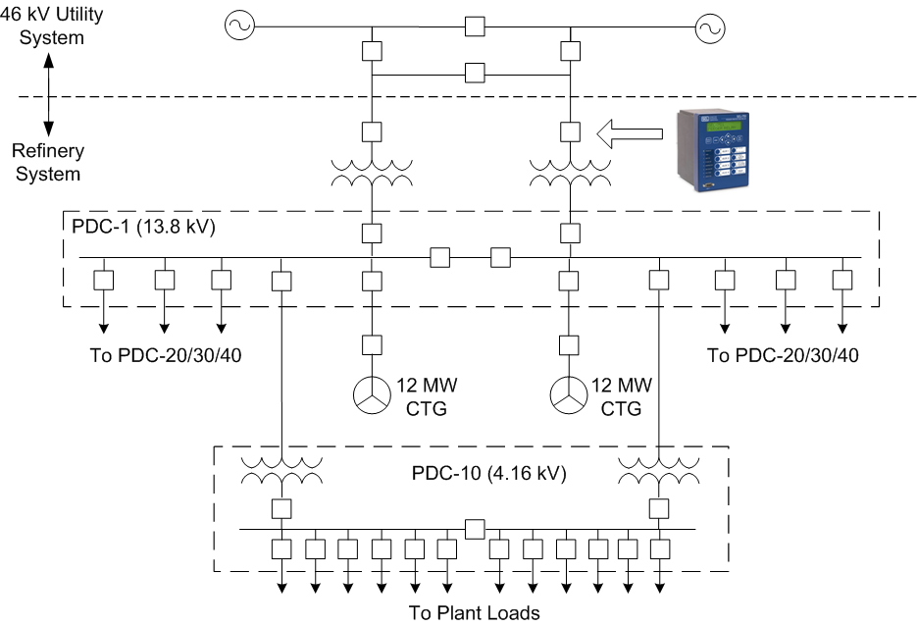
System Overview

Slide 4
Need for Power Management System
Plant load 18 MW prior to upgrades
Several expansion projects executed during course of reliability improvements
By cutover in March 2015, load grew to 25 MW
Generators capable of 18.4 – 24 MW
Utility source provides balance
Load shedding scheme required to keep Co-Gens running during islanding
Loss of Co-Gens results in costly outage due to loss of steam

Slide 5
Power Management System Overview
Contingency-based scheme
Central controller monitors system conditions
Controller calculates amount to shed in real-time for pre-defined “contingencies”
Requires protection-speed communications
Met performance requirements identified during preliminary studies
Protection network already in place for GOOSE schemes at plant
GOOSE selected as protocol for load shedding

Slide 6
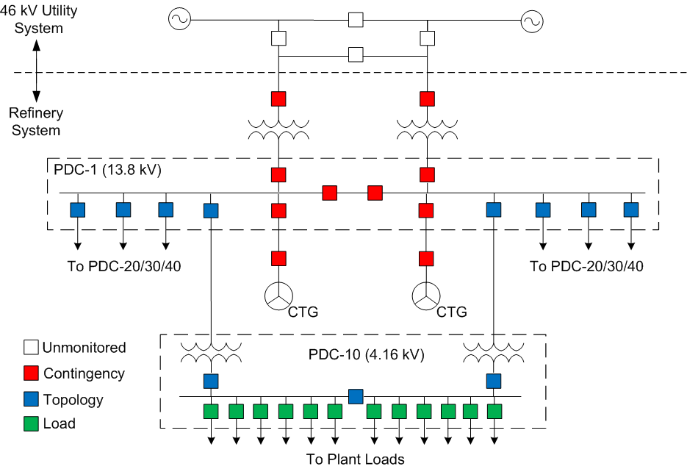
Contingency Scheme Overview
Three Breaker Types
Contingency
Change of state can initiate load shed
Monitor status and power import
Topology
Status used to determine system configuration
Load
Monitor power consumption
Tripped during load shedding event

Slide 7
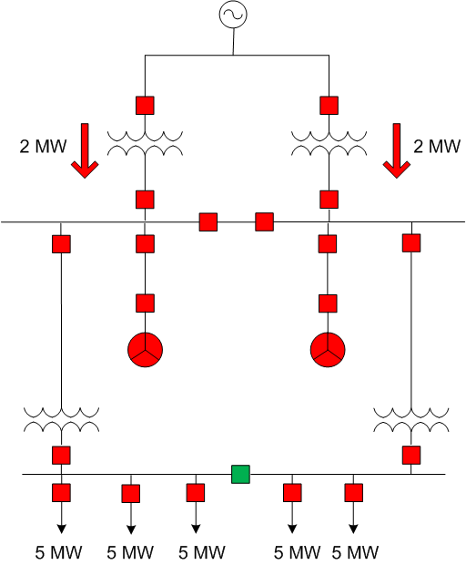
Contingency-based Scheme Example
Shed load when both main breakers open
Shed pre-event import plus margin
Decisions based on real-time metering and breaker status from field devices

Slide 8
Contingency-based Scheme Example
Scheme must shed 4 MW, plus small margin
Lowest-priority 5 MW feeder selected to trip
Controller will trip feeder if contingency trigger occurs

Slide 9
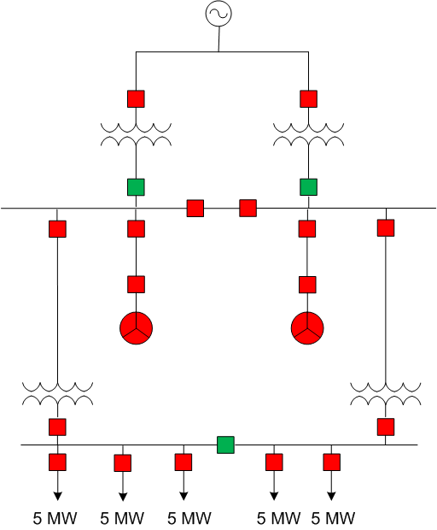
Contingency-based Scheme Example
Main breakers trip for utility undervoltage

Slide 10
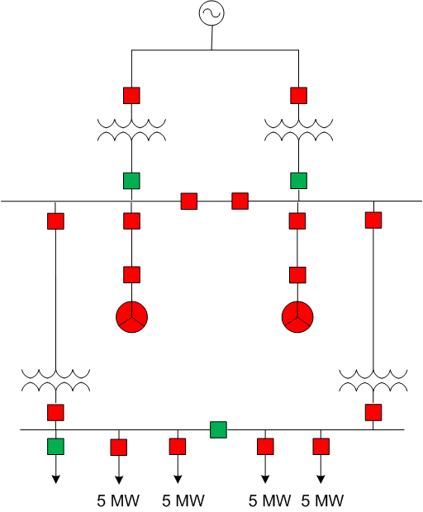
Contingency-based Scheme Example
Pre-selected feeder tripped by controller

Slide 11
Testing Approach
Bench Test
RTDS testing selected due to complexity and criticality of system
Allowed for thorough closed-loop testing
Allowed scheme controllers and IEDs to be interfaced with test system
Site Acceptance Test
Communications checks
Limited set of functional tests
Islanding events during plant outage with simulated load

Slide 12
Lesson 1 – Accurately Characterize the System
Generator dynamic model validation
System modeled in phasor domain software
Determined performance requirements for power management system
Limit assumptions about system parameters
Increased confidence in model

Slide 13
Lesson 2 – Thoroughly Test System Operating Modes
Accurately model plant and nearby utility system
Examine normal and contingency cases
Existing and future loading
Variety of initiating conditions for islanding events
Determine controlling cases
Scheme performance for all cases verified with RTDS
Focus on controlling cases

Slide 14
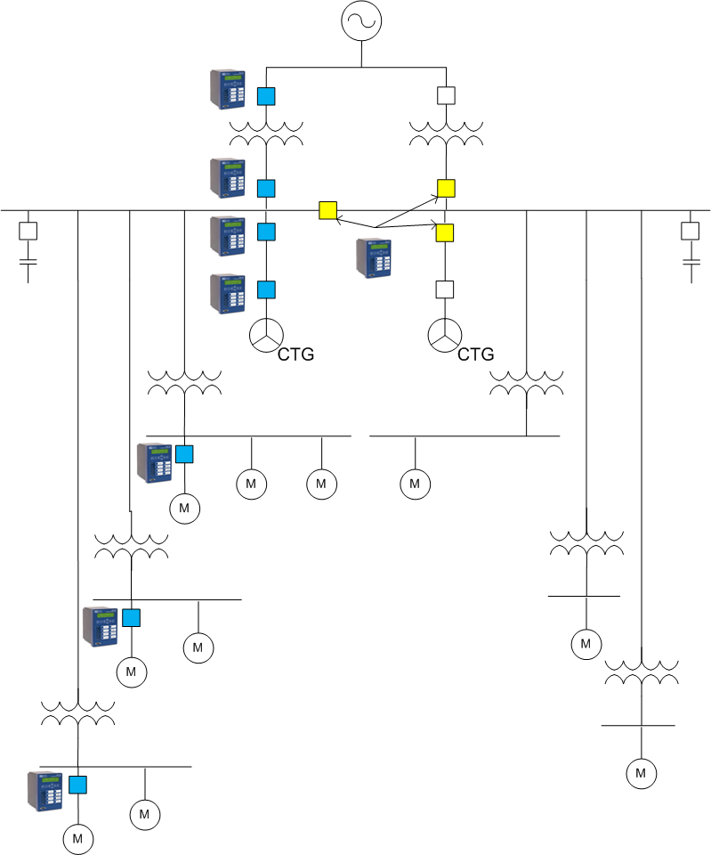
Lesson 3 – Include at Least One of Each Device Type in the Bench Test
Actual relays and controllers
Contingency and load breaker relays
Problem with GOOSE analog values
Required re-design of frequency-based triggers
Problem may not have been identified using traditional bench test method

Slide 15
Lesson 4 – Test System Failure Modes
Verify scheme operation during failure modes
Unintended operations not tolerated
Failure modes considered
Communications failure
Settings changes
Loss of IED power
Failure mode testing
Security issue identified in controllers during re-establishment of communications
52A status issue uncovered during DC power failures

Slide 16
Lesson 5 – Identify FAT and Commissioning Test Boundaries
Factory Acceptance Test
Realistic testing in consequence-free environment
Not impacted by operational restrictions or outage duration
Response of entire system viewed by design team
Test power management system for all foreseeable contingencies
Verify logic of controller and each unique IED type in system
Minimize exposure to field changes

Slide 17
Lesson 5 – Identify FAT and Commissioning Test Boundaries (Continued)
Site Acceptance Test
Keep testing succinct to limit outage duration
Live islanding tests not practical
Focus on items not verified in lab
Communications checks
I/O, controls, and alarm verifications

Slide 18
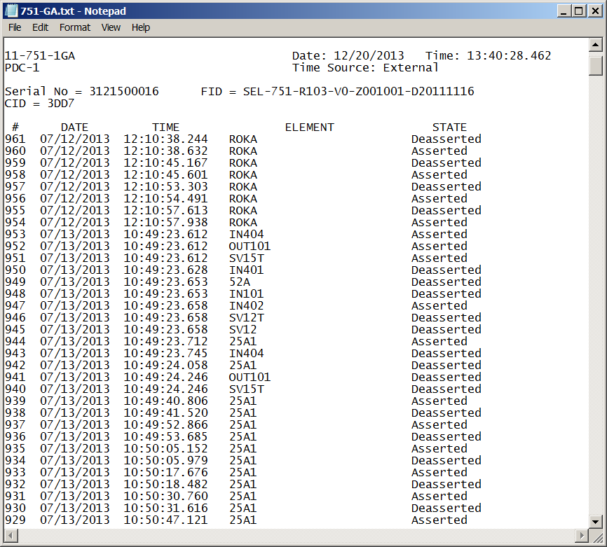
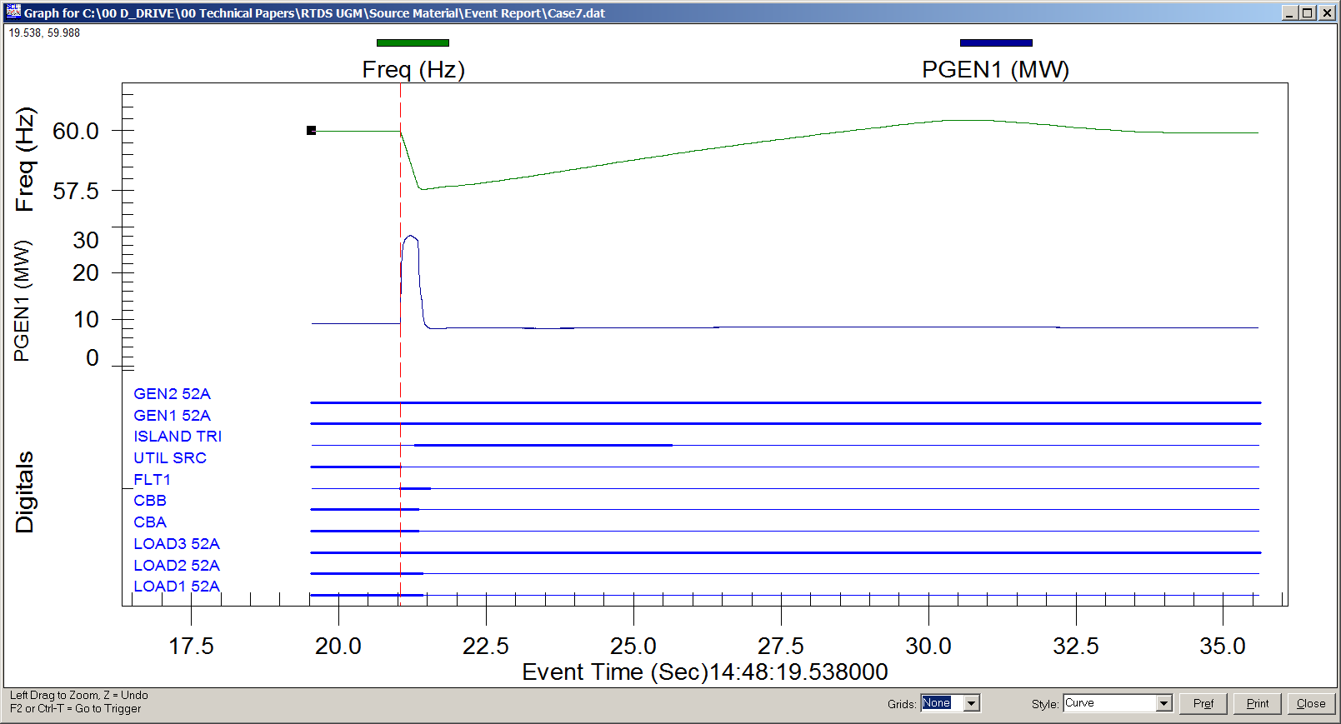
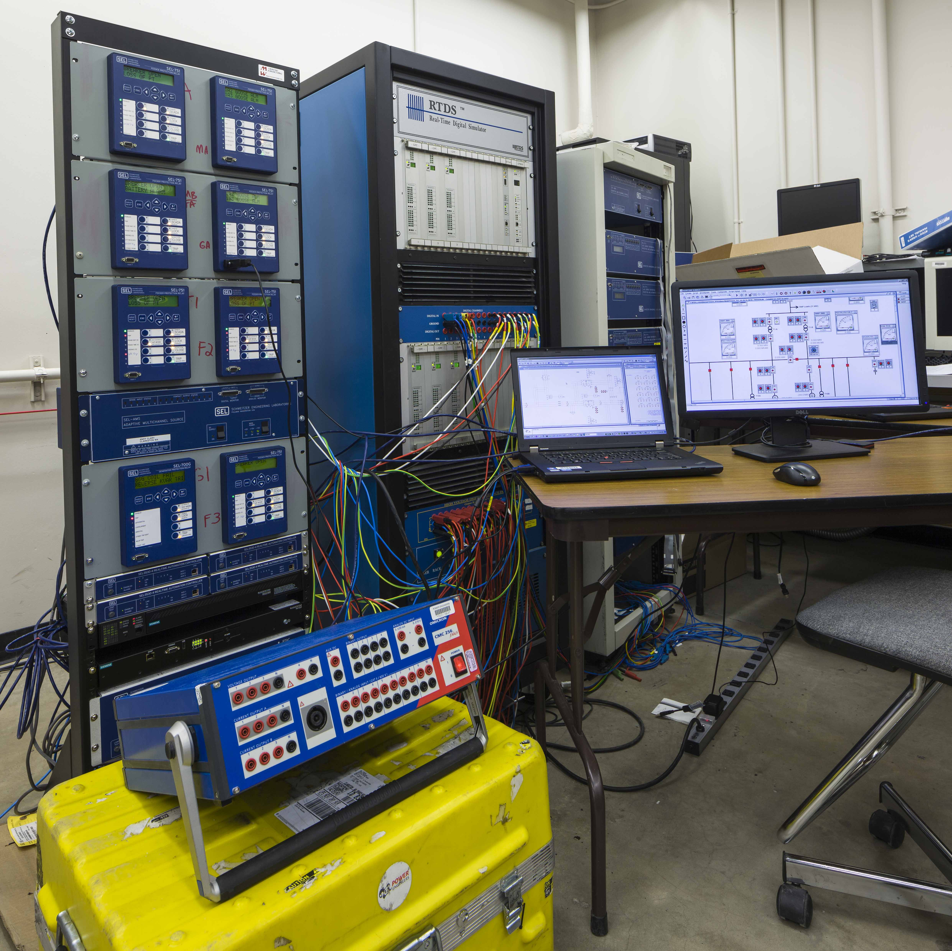
Lesson 6 – Carefully Preserve System Test Details
Bench Test Setup
RSCAD Model, Photos of Setup, Wiring Diagrams
Allows test environment to be recreated
Bench Test Results
COMTRADE captures from RTDS
Device SERs captured for all tests
Automated tests for controller logic
Site Acceptance Results
Device SERs and relay event reports captured
Test results provide a known reference point for comparison with actual field events.

Slide 19
Conclusions
IEC61850 GOOSE messaging provides flexibility for protection and control systems
Protection-class network required
RTDS testing provides thorough performance validation
Thorough lab testing for complex systems minimizes field changes and improves final product

Slide 20
Questions?

