Slide 1
Development of Cyber-Aware Energy Management System Applications
Yannan Sun, Siddharth Sridhar, Mark J Rice, and Mallikarjuna Vallem
Pacific Northwest National Laboratory

Slide 2
Outline
Motivations
Cyber-aware State Estimation Framework
Cyber-aware Contingency Analysis Framework
Cyber-physical data creation
Modeling the SCADA network
Modeling cyber vulnerability
Conclusions and future work

Slide 3
Strategy: DOE-OE Control Systems Roadmap
CEDS/NSTB (OE-10) Research Agenda
Original Roadmap 2006, updated 2011
www.controlsystemsroadmap.net
Challenges:
Address Roadmap with partnered research leading to commercial solutions
Influencing Supply Chain
Advanced Persistent Threat
Advanced – Operators behind the threat utilize the full spectrum of intelligence gathering techniques.
Persistent – Operators give priority to a specific task over time, rather than opportunistically seeking to achieve the defined objectives.
Threat – Means that operators have a specific objective and are skilled, motivated, organized and well funded.
“In 10 years, control systems for critical applications will be designed, installed, operated, and maintained to survive an intentional cyber assault with no loss of critical function.”

Slide 4
Motivation
Modernization of the electric grid will increase its vulnerability to potential cyberattacks.
Grid operators are monitoring the electrical system 24/7
They are first to notice inconsistency/misbehavior in SCADA system.
Cyber SE can help confirm their observations.
Operation of electrical system requires proper communications between control center substations
Operators need to be able to relate possible lost of communications to ability to control the grid.
It is necessary to consider cyber information for contingency analysis.
Notes:
As the grid is modernized and the Smart Grid is deployed, new intelligent technologies utilizing two-way communications and other digital advantages are being optimized by Internet connectivity. Modernization of many IC systems (in particular, the Supervisory Control and Data Acquisition [SCADA] system) also has resulted in connections to the Internet. While these advances will improve the efficiency and performance of the grid, they also will increase its vulnerability to potential cyberattacks.
Addressing cybersecurity is critical to enhancing the security and reliability of the nation’s electric grid. Ensuring a resilient electric grid is particularly important since it is arguably the most complex and critical infrastructure that other sectors depend upon to deliver essential services.

Slide 5
Cybersecurity for EMS Decision Support Tools
Purpose: Define cybersecurity functions that can be added to EMS decision support tools.
Challenge: Understand where EMSs can be extended to include Cybersecurity in the decision-support process. Functions such as State Estimator (SE) and Contingency Analysis (CA) can consider the impacts of cybersecurity scenarios in their EMS study functions.
Technical Approach: In EMS power system planning functions, consider:
Providing SE observability regarding each communications channel
Adding cybersecurity contingencies into the existing CA function
Providing a test system for showing the effectiveness of the proposed algorithms
SCADA
Power System Network Model
EMS Real-Time Sequence
EMS Study Sequence
Model Update
Optimal Power Flow.
State Estimator
Short Circuit Calc
Contingency Analysis
Contingency Analysis
Started May 2013
Partners:
Alstom Grid,
Siemens,
Centerpoint Energy,
Sempra/SDG&E
Notes:
Under DOE Cybersecurity for Energy Delivery Systems Program

Slide 6
Cyber-Aware State Estimation
Cyber Events
Possible Compromised measurements (PCM)
Measurements from Field
Use normal statistical assumptions for PCM
Power Grid
Reduce weights for PCM
Noise
Bad Data Detection
True
measurements
+
State Estimator
Bad data
detected?
N
SE Results
Y
Bad Data
Remove bad data
N
Is bad data
in PCM set?
Y
Y
Current weight
sufficiently small?
Reduce weights again
N

Slide 7
Cyber-Aware Contingency Analysis
Traditional Contingency Analysis
Power Grid
Compute Line Outage Distribution Factors
N-1 Contingency analysis for power grid
Identify critical lines
Ranking of all analyzed contingencies
Select k
SCADA N/W Configuration
Offline cyber vulnerability assessment
Estimate probability of substation N/W compromise
Partial N-k Contingency analysis for cyber events
SIEM logs
Info from
SE + BDD

Slide 8
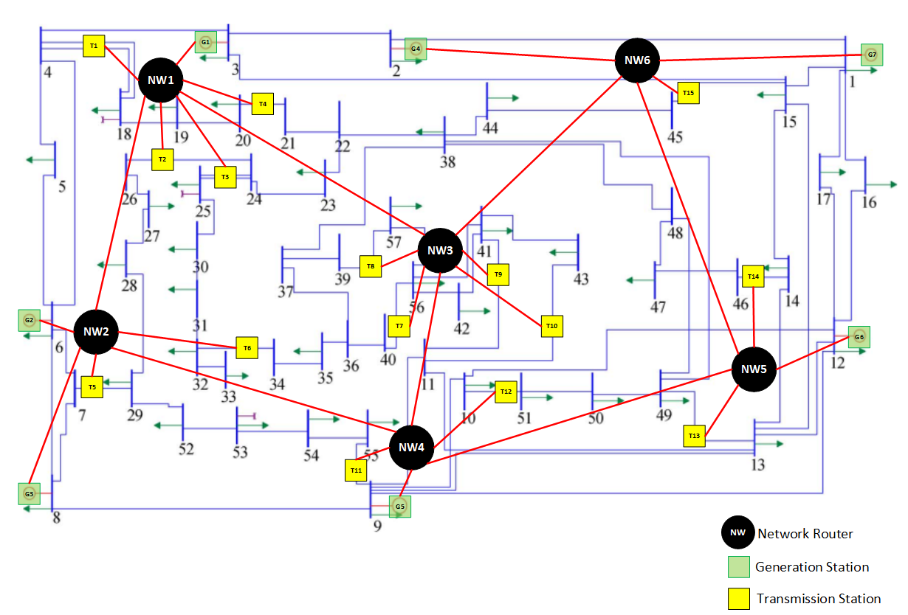
Design of Cyber Network Topology
Selected system: IEEE 57 bus system
7 generation stations
15 transmission substations
22 substations to be modeled
6 network routers to be modeled

Slide 9
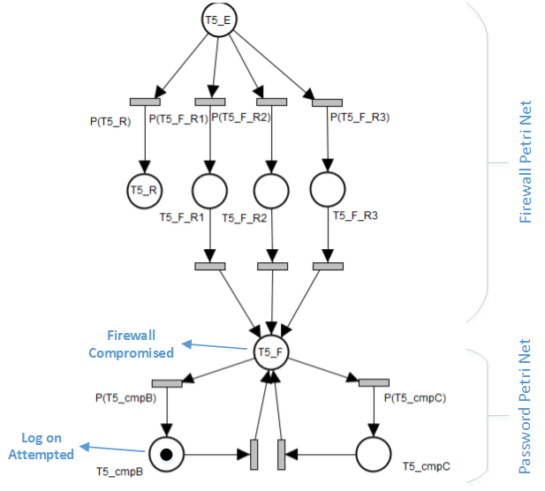
Petri Net Modeling
Assumptions:
Every substation has one firewall and one computer
If the computer is compromised, an attacker is able to perform switching operations within the substation
An attack originates at a certain router. The point of attack origin affects the model results.

Slide 10
Vulnerability Analysis Results
Substation # | Risk | Substation # | Risk | Substation # | Risk
1 | 0.154 | 6 | 0.032 | 11 | 0.011
2 | 0.098 | 7 | 0.019 | 12 | 0.012
3 | 0.110 | 8 | 0.020 | 13 | 0.010
4 | 0.096 | 9 | 0.022 | 14 | 0.012
5 | 0.037 | 10 | 0.019 | 15 | 0.010

Slide 11
Contingency Ranking with Cyber Information
Vulnerability/Risk level of substation $i$: $R_{i}$ (learned offline)
Probability of compromise for substation $i$: $P_{i}$ (learned online)
The updated impact factor of contingency ‘$j$’:
$\tilde{impact_{j}}=impact_{j}⋅R_{i}⋅P_{i}$
The contingencies are ranked by their updated impact factors

Slide 12
Conclusions and Future Work
Improved existing SE and CA algorithms by considering cyber information
Provided a cyber-physical test system for simulation studies
SIEM logs
Possible Compromised measurements (PCM)
Cyber Contingency Analysis
Cyber State Estimation
Cyber CA
Measurement from field
State Estimator
Bad data Detection
SE Results
Ranking of all analyzed contingencies
Alarm processing
Traditional CA

