Slide 1
Synchrophasor Implementation Experience and Integration Challenges in Indian Grid
Authors :
P. Mukhopadhyay, Abhimanyu Gartia, Samit Kumar Saha,
Rajkumar Anumasula, Chandan Kumar, Sunil Patil, Srinivas Chitturi

Slide 2
Outline
Indian Grid Overview
Synchrophasor Initiative in India
Challenges during Implementation
Conclusion

Slide 3
Indian National Grid
Demarcated into Five Regions.
Installed Capacity : 276.7 GW (as on 31st July 2015)
Peak Demand : 141 GW (as on 31st Sept 2015)
More than two Generation Complexes > 4000 MW
765 kV and 400 kV Lines for EHV transmission system.
Rapid Pace of Growth in generation, Transmission and Distribution.
Renewable Generation : 36 GW ( Wind : 23.7 GW, Solar : 4 GW) : On increasing trend
Use of Synchrophasor Measurements for Grid Operation.
Northern Grid
North
Eastern
Grid
Eastern
Grid
Western Grid
Southern
Grid

Slide 4
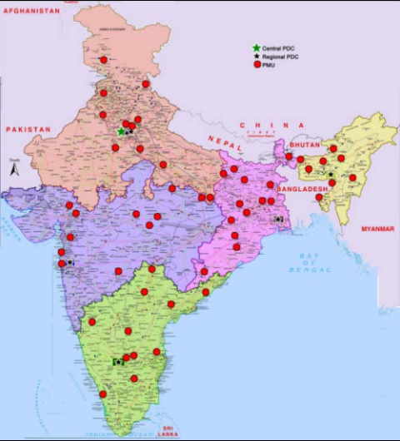
Synchrophasors Initiative in India
Six Pilot projects on PMUs
More than 60 PMUs from Different Vendor.
Integration at National level.
Utilization for real time power operation :
Fault detection, localization and Characterization
Oscillation monitoring
Angular stability monitoring
Synchronization and Islanding of large Regional Grids
Operator actions based on monitoring of synchrophasor data.
Public Reports : Synchrophasors Initiative in India, June 2012 and December 2013, Power System oscillations Sept 2014
URTDSM Project to have more than 1700 PMUs

Slide 5
Challenges faced during the Implementation of Synchrophasor Project in India
Implementation Experience in Multi-Vendor environment
PMU Synchronization Error.
Communication Challenges in Integrating PMU
Reliability of Synchrophasor data.
Calculation of Sequence Components at PDC level.
Synchrophasor Measurement Angle unwrapping.
Computation Challenges at Historian within 20ms.
Integration with SCADA State Estimator/EMS challenges

Slide 6
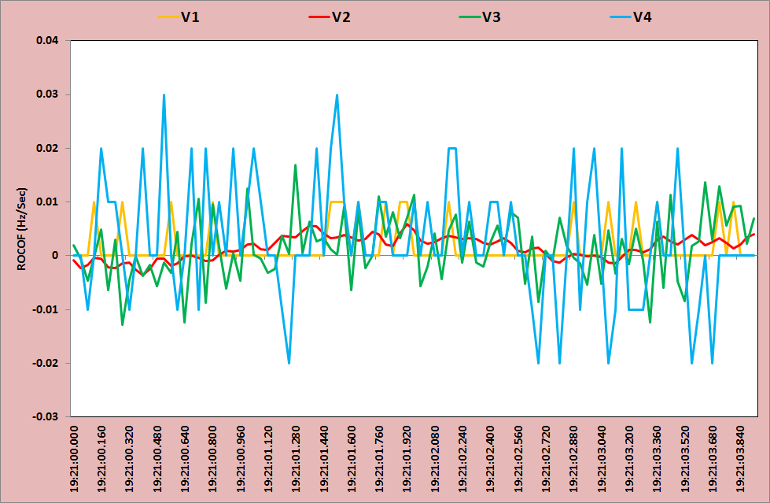
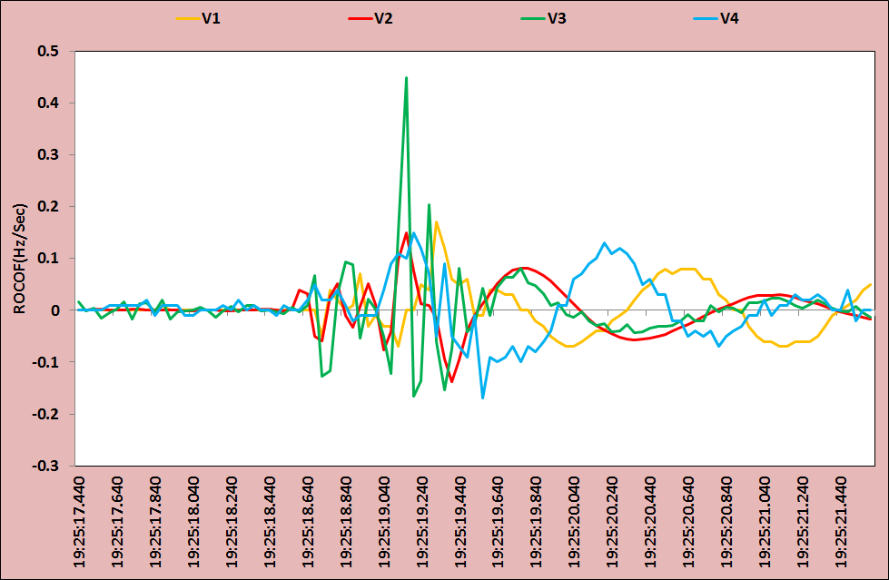
1. Implementation Experience in Multi-Vendor environment
Standard has evolved : IEEE C37.118-2005/2011 , PDC Guide IEEE C37.244-2013
Different precision in the measurement quantities
Challenges :
Visualization
Oscillation Monitoring
Event alarms.
Non-Availability of Positive sequence component:
Issue with Linear state estimation.
Estimated phase angles at same sub station from different vendor PMUs needed to be within a tolerance band.
Line Voltage angle
Bus side Voltage Angle
Figure : ROCOF observed from four different PMUs during quasi steady state operation
Figure : ROCOF observed from four different PMUs during transient condition

Slide 7
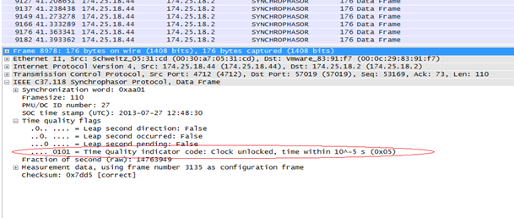
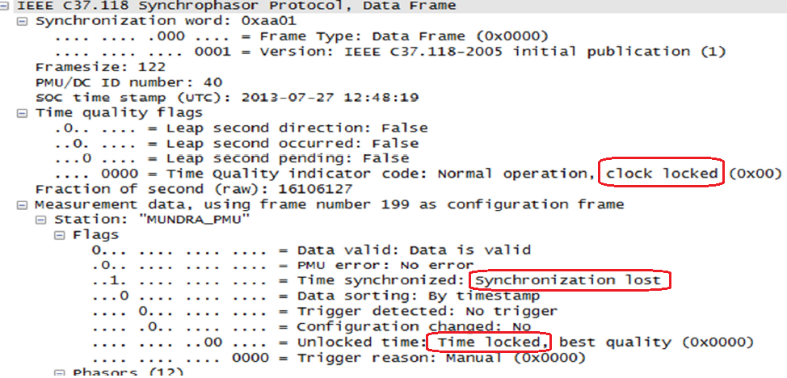
2. PMU Synchronization Error.
PMUs are located at remote location sub-stations
Synchronization may be lost in far away PMUs due to various reasons.
Utilization of Flags from the PMUs for time synchronization and FOS is important.
Helps in identifying issues and finding a solution to resolve them.
Figure : Unlocked clock status in time quality flags in C 37.118 Data frame
Figure : Time Quality Flags in C 37.118 Data frame showing normal, locked clock

Slide 8
3. Communication Challenges in Integrating PMU
Heart of the whole WAMS system.
Major Challenge : Establishing high bandwidth communication links between geographically remote substations to RLDCs.
Communication Channels used in India for WAMS :
Dedicated fibre optic channel
Enterprise Wide Area network
Leased communication lines.
Bandwidth : 64 kbps or 512 kbps or 2 mbps channel
Observation :
64 kbps : High latency
2011 standard PMUs has high latency compared to 2005
Need of optimization : Usage of communication channel bandwidth with large number of PMUs installation at one station.
PMU Make | IEEE Standard | Composition of Signals |  |  |  | Communication Bandwidth average latency (in ms)
 |  | Phasor | Analog | Frequency | Total | 64 kbps | 512 kbps | 2 Mbps
Make 1 | C.37.118-2011 | 12 | 8 | 2 | 22 | 625 | 350 | 300
Make 2 | C.37.118-2005 | 6 | 32 | 2 | 40 | - | - | 50
Make 3 | C.37.118-2005 | 12 | - | 2 | 14 | - | - | 60
Make 4 | C.37.118-2005 | 18 | 4 | 2 | 24 | - | - | 160
Make 5 | C.37.118-2005 | 13 | 3 | 2 | 18 | - | - | 150
Figure : Average Latency observed with different communication channels and PMUs

Slide 9
4. Reliability of Synchrophasor data.
Reliability of the Synchrophasor data is of utmost importance.
Unreliable Data : False alarms , Incorrect decision making
Even with a healthy PMU in place, there had been instances of data loss which are due to:
Issues with the Communication link between PMU and PDC.
Loss of time synchronization of individual PMU
Application Algorithm/ Historian Capability : Discard the unreliable data.
Example : Applications like Oscillation Monitoring System (OMS) and Angle Monitoring Applications need to detect such conditions for better Visualization and Result.

Slide 10
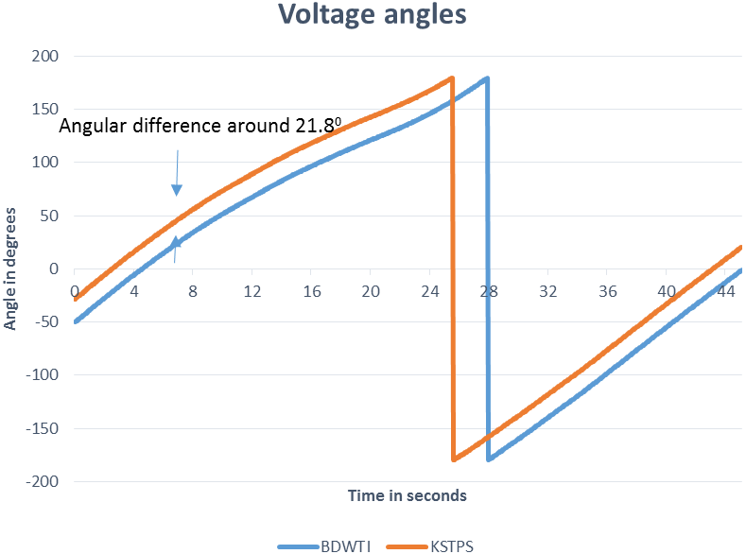
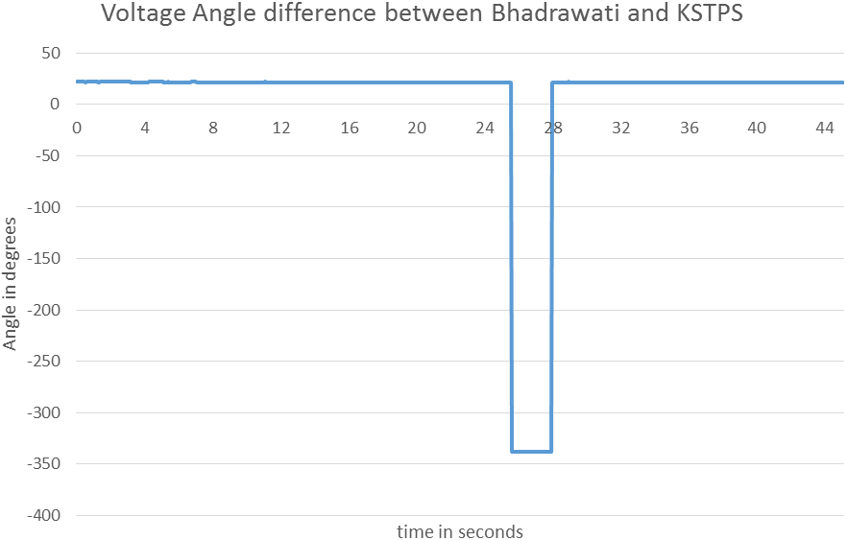
5. Synchrophasor Measurement Angle unwrapping
Angular separation measurement is the core use of Synchrophasor measurements in Real time to know stress in the grid network.
Earlier it was only possible through state estimation .
Synchrophasor reporting over a range of ±π radians or ±180º : Discontinuous Signal.
Subtraction of two discontinuous angles results in a discontinuous signal
Commonly available unwrapping algorithms can solve the problem.
Challenge : Handling a few thousand PMUs

Slide 11
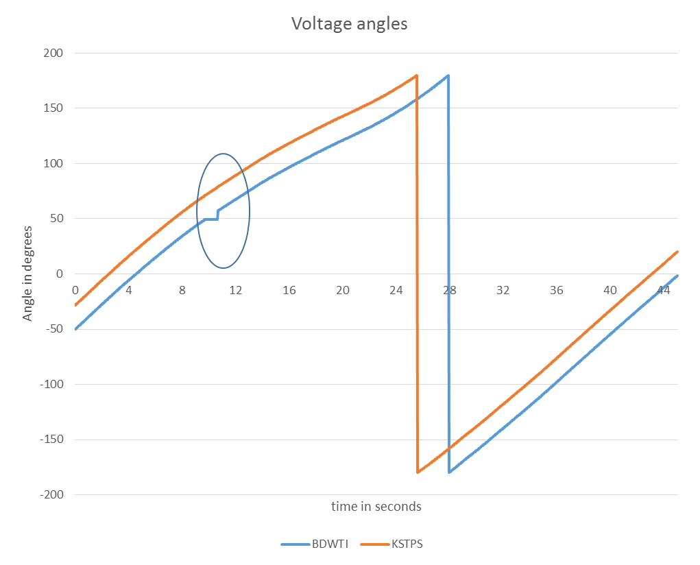
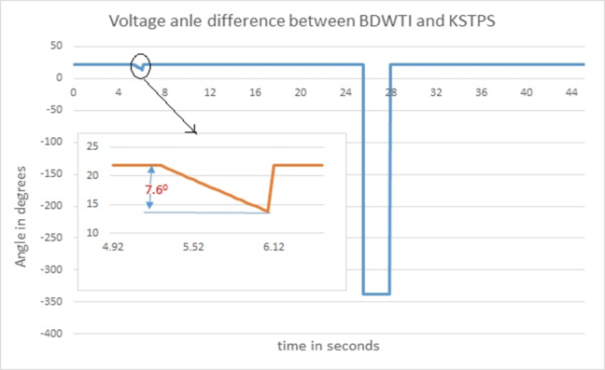
Challenge : Handling Missing Data frames with few Thousand PMUs
Analytics Engine Should be Intelligent : Unwrapping angular difference with missing data and synchronization issues.
Unwrapping algorithms : run in Real time without taking significant calculation time
Selecting reference angle for calculation of relative angles :
Calculate Center of Inertia (COI) and take the nearby PMU as reference angle.
Check df/dt for typical event; take nearby PMU angle, which is having highest df/dt as reference.
Take generation rich area PMU angle as reference and calculate relative angles of other load rich areas.

Slide 12
6. Computation Challenges at Historian within 20ms
Simple mathematical calculations on each sample to be performed in real time.
Reporting rate of PMU to PDC : India has 25 frames/seconds
Every 40 millisecond, there is a new measurement available at PDC or historian.
Calculation output should be available for visualization before next arrival.
Execution speed to be less than 20 milliseconds or better for all calculations.
7. Calculation of Sequence Components at PDC level.
The use of sequence component is very well known in the power system.
Some PMU manufacturers do not provide a complete set of sequence components.
One of the option is to calculate the sequence components of voltages and currents at the PDC.
This is good as long as the number of PMUs being supported is not high.
With large number of PMUs, calculating sequence components in PMU shall be a preferable option.
Vendors need to implement functionality as an optional feature.

Slide 13
8. Integration with SCADA State Estimator/EMS challenges
Integrating SCADA and WAMS vital in view of better utilization.
Few ways to integrate WAMS data to SCADA :
ICCP
IEC 60870-5-104
POSOCO used ICCP and IEC 60870-5-104 for integration.
Following points were found to be important to consider during such integration efforts:
Down sampling of phasor data to a level compatible to SCADA
PDC shall be able to send Angular Difference measurements to SCADA system (No Absolute angles).
Negative effect on State estimator convergence based on Phasor measurement to be considered .
Angular difference : Reference bus in PDC & Slack bus in State estimator should be same.

Slide 14
Conclusion
Several challenges discussed
Few solutions based on experience
Vendors to put lot of effort for large scale PMUs project
Need to be solved by common specification and proper compliance of PMUs to relevant standards.
Communication Challenges and its optimisation issues need to be studied in detail prior to implementation of project.
Utilization related data also needed to be addressed during application development by Vendors or Users.
Overall, this paper provides a feedback for implementation of large-scale project on WAMS in any electrical grid in future.
Feedback to developers and designers in the WAMS area for making the technology more robust.

Slide 15
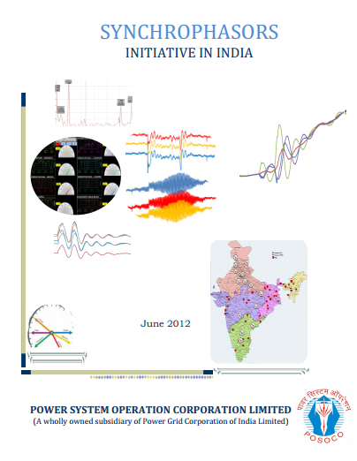
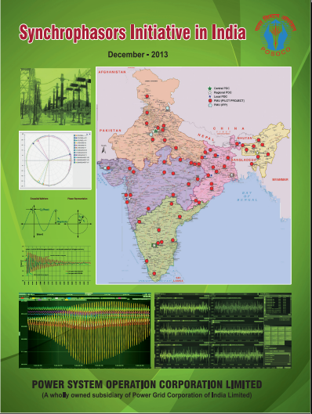
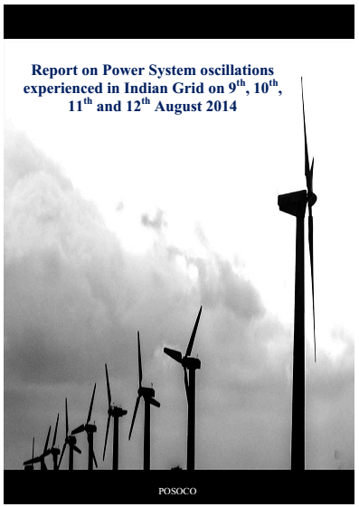
Conclusion…..
POSOCO publishes annual report based on its experience in the field of Synchophasor technology.
POSOCO Reports are made public for the benefit of Power system Community.
The second report on “Synchrophasor Initiative in India ” Dec-2013 was launched in Dec’2013.
The third Report on “Low Frequency Oscillation” has also been published in Sept-2014.
Report links are : http://posoco.in/2013-03-12-10-34-42/synchrophasors

Slide 16
Email : chandan.wrldc@posoco.in
Phone : 022-28315199

