Slide 1

Standards Are Note Enough!
Challenges of IEC- 61850 Interoperability
Ameen Hamdon, President, SUBNET Solutions Inc.
CANADA

Slide 2

Happy Canadian Thanksgiving!

Slide 3








The “Smarter” Grid Tomorrow – The Risk and Reward?
Our Utilities will accelerate deployment of many different IEDs & Business Intelligence systems.
Without good standards, this will create a complexity that could become unmanageable.

Slide 4
Utility Real Time Integration complexity today is much more than just SCADA Protocol Translation
SCADA and Non-SCADA data substation communications
Fault File Management
Remote Engineering Access (CIP-005, CIP-007)
Password Change Management (CIP-005, CIP-007)
Configuration Management (CIP-010)

Slide 5
IEC-61850 Marketed Promise
UCA/IEC-61850 had been marketed for approximately 15 years as the Electric Utility answer for….
  Multi-vendor Interoperability
  Reducing IED Integration complexity
    Self Description, etc
  Enabling engineering efficiencies
    Configuration and Testing

Slide 6
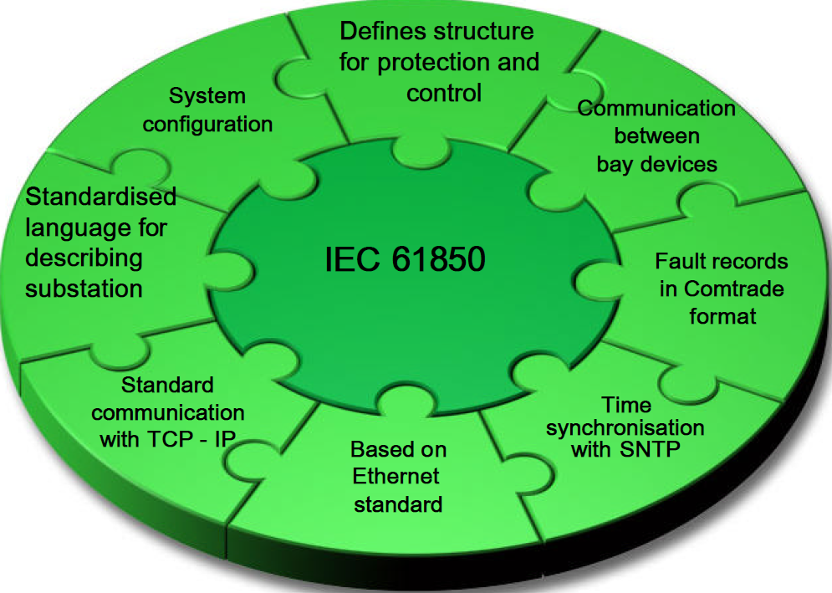
Using IEC 61850 is intended to assist with this complexity

Slide 7
Presentation Overview
This presentation outlines recent history of the state of IEC-61850 Interoperability
  Review Results from Recent IEC-61850 IOPs
  Review Issues and Solutions for a Major
  Multi-Vendor IEC-61850 Utility Project
  Discusses vendor business cases “for” and “against” effective Multi-Vendor IEC-61850 Interoperability

Slide 8

Single Vendor IEC 61580 Interoperability = Okay
Gateway
HMI
61850
Relay
Relay
Relay
Gateway
HMI
61850
Relay
Relay
Relay

Slide 9
What about Multi-Vendor
IEC-61580 Interoperability?
?
Gateway
HMI
IEC-61850
Relay
Relay
Relay
Relay
Vendor
A
Relay
Vendor
B
Relay
Vendor
C

Slide 10
Recent IEC 61850 Interoperability Panels
# | Date | Event Name
1 | April, 2011 | UCA IEC 61850 IOP
2 | October, 2013 | UCA IEC 61850 IOP
3 | August, 2014 | Cigre Paris 2014 IEC 61850 IOP
4 | September, 2015 | UCA IEC 61850 IOP

Slide 11
IEC 61850 IOP Interoperability Issues - 2011
Issues found between vendor files
  Incorrect initialized values.
  Issues found between vendor implementations
    Support of Integer 128 issues
      Inability to “to map/support such a value in the implementations memory/application”
  “Vendor A attempted to import an SCD file exported by Vendor B. A problem occurred. The problem was diagnosed to be an unsupported XML Namespace issue”

Slide 12
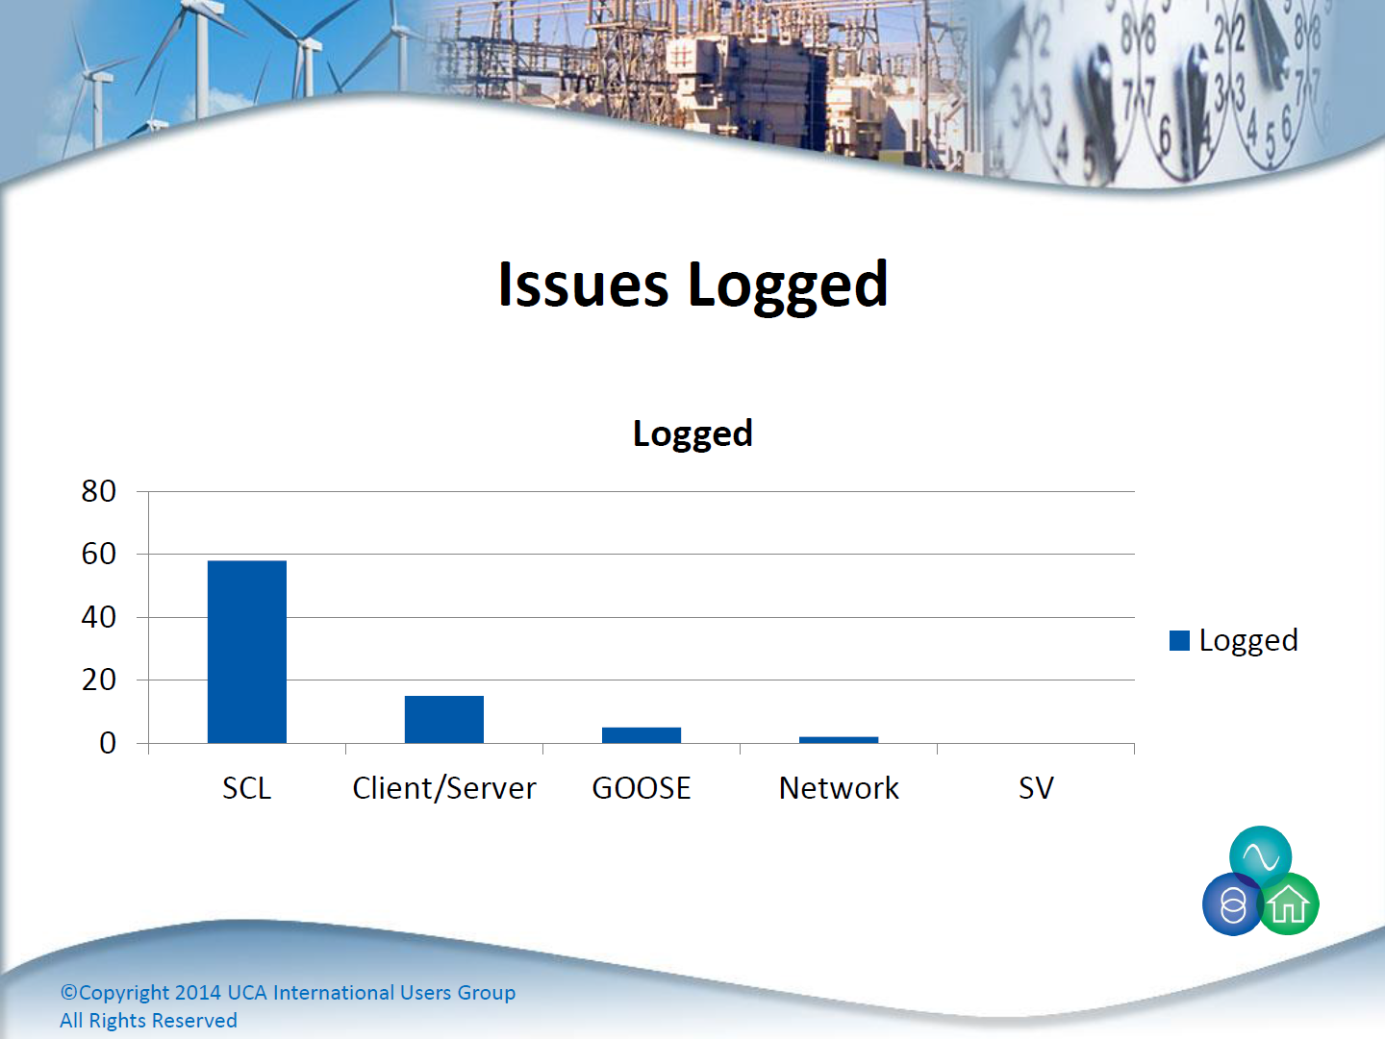
IEC 61850 IOP Interoperability Issues - 2013

Slide 13
IEC 61850 IOP Interoperability Issues - 2013
61850 Standard Issues from the report:
  SCL
    “ED.1/ED.2 co-existence in a single SCD file”
    “Client reporting subscription”
    “GOOSE subscription”
    “SV subscription”
  Networking
    “VLAN Tag 0 support in switches”

Slide 14
IEC 61850 IOP Interoperability Issues - 2013
“Engineering efforts required to implement the standard in a substation are huge”
“Grid operators are forced to use specific vendor tools that are not optimal in a multi-vendor environment and train staff to use a wide range of tools to configure the system”
“A clear move by the market to a top-down approach using standardized third-party tools is needed”

Slide 15
CIGRE 2014 IEC 61850 IOP Interoperability Issues
Incorrect SCD/CID File Formats
Problem: Vendor tools create incorrect CID file formats
  Issue: Found several instances of missing DOType, DAType, ENUM, and ConnectedAP definitions
  Issue: Point IDs created to be too long and incompatible with certain 61850 server driver implementations
Solution: Vendor enhancement requests

Slide 16

IEC 61850 2015 IOP Event Details
Brussels, Belgium
7 days
Sep 26th – Oct 2nd
100+ Participants

Slide 17
IEC 61850 2015 IOP Participating Companies
ABB
Alstom
CG Global
Efacec
ERLPhase
GE
Megger
Omicron
Schneider Electric
SEL
Arc Info
Copa Data
EDF France
Elia
Epri
Kalkitech
Koncar
Novatech
Ren
RTE France
SUBNET Solutions Inc.
SAE
SISCO
Sprecher Automation
Tesco Group
Toshiba
Triangle Microworks
TUEV
Xelas
Zamiren

Slide 18
IEC 61850 2015 IOP Preparation & Planning
Preparation and planning
  Bi-Weekly web meeting
  Started March 18 for a total of 14 meetings
  114 people
  Equals 1,596 man hours in prep
Slides details success and failure (issues) – TBD report yet to be issued (UCA UG @ DTECH)

Slide 19
The Reality of 61580 Interoperability
Maturity of IEC 68150
Component | Maturity Level
MMS/GOOSE | HIGH
Semantic Model | MEDIUM
Engineering Tools | LOW
What does Interoperability mean?
Vendors want… Co-existence
Utilities want… Interchangeability
Notes:
3 layers of 61850
1. MMS/Goose Level – Protocol – quite mature, things work fairly well these days
2. Semantic Models – Logical Nodes, ENTSO-E (European Network of Transmission System Operators for Electricity?). Provide Prescriptive guidance on what of all the numerous options 61850 could do things to get consistency across vendors) is getting involved to write a large number of Application Profiles. (generally speaking it is the equivalent of DNP SUBNET Definitions) ENTSO thinks this work cold take up to 7 years (2022, 23)\
Engineering Tools – IEC-61850 Interoperability – SCL Interoperability – Substation Configuration Language - Open Standard/Vendor Agnostic tooling. At a very early stage, its not there and its doesn’t work.

Slide 20
A North American Interoperability Challenges List
Point Naming Differences
  Some use generic names
  Some use specific contextual names
Configuration Parameter Differences
  Disallowing one vendor’s IED to subscribe to GOOSE message from the other vendor’s IED
Challenges with SCD Configuration Files and how they are uploaded to devices
  Needed to use the Private Data sets to support the different Settings file and IEC-61850 File – no area within the native IEC-61850 file.

Slide 21
A North American Interoperability Challenges List
Different limits for number of publishing messages and number of subscribing messages
Some do not support priority tagging for GOOSE messages
Some do not support VLAN identifiers for network segregation
Automatic configuration using vendor SCD/ICD/CID files was impossible.
Notes:
Perform protection or automation differently (IEC 61850 standard does not specify how to perform these functions)
Some use generic naming, some use specific contextual name (making data mapping difficult when IEDs are talking to each other)
Configuration parameters are different, disallowing one vendor IED to subscribe to GOOSE message from the other vendor

Slide 22
Using IEC 61850 can assist with the complexity
Vendor
Specific
Vendor
Specific
File naming, file collection
Vendor
Specific
File naming, file collection
Vendor
Specific
PRP/HSR
RCB
Notes:
Inconsistency issue affecting effective interoperability

Slide 23
Result of IEC-61850 Issues
Many Utilities concerned about doing their own integration
Thus many seek turnkey integration solutions for device Vendor
Device Vendors typically supply Single Vendor solutions vs Multi-Vendor
Bottom Line: Ongoing Vendor Specific issues hurt Utilities, help Device Vendors

Slide 24
IED Vendors Smart Grid Business Case for Profit Maximization
IED Vendors Goals to
Grow IED Business
IED Vendor Specific Strategy to
Grow IED Business
Sell More IED
Sell newer, more expensive IEDs
Encourage More Frequent IEDs Replacement
Vendor Specific IOP helps grow market share vs IED Competitors
Create newer IEDs models with new, continually evolving protocols
Accelerate product obsolescence, discontinuance.

Slide 25
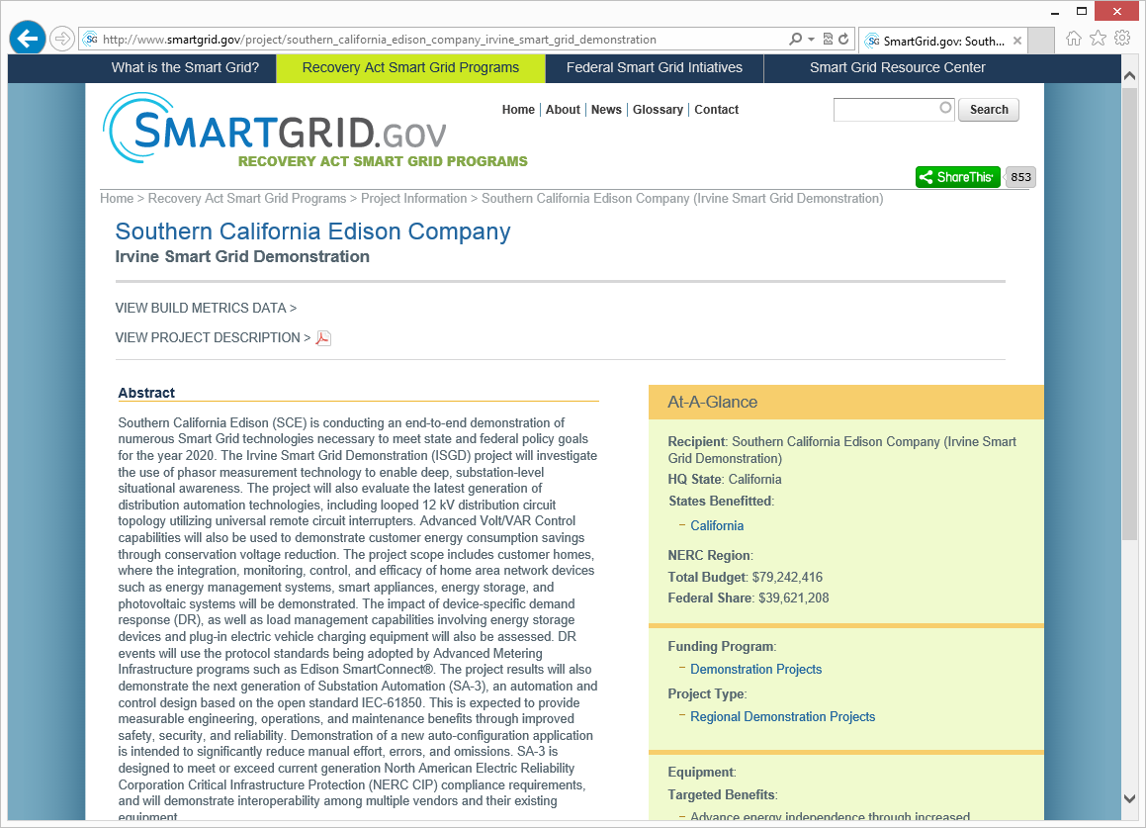
Southern California Edison
Irvine Smart Grid Demonstration
“The project will demonstrate the next generation of automation and control design based on the open standard IEC-61850.
This is expected to provide measurable engineering, operations, and maintenance benefits through improved safety, security, and reliability.
Demonstration of a new auto-configuration application is intended to significantly reduce manual effort, errors, and omissions.”

Slide 26
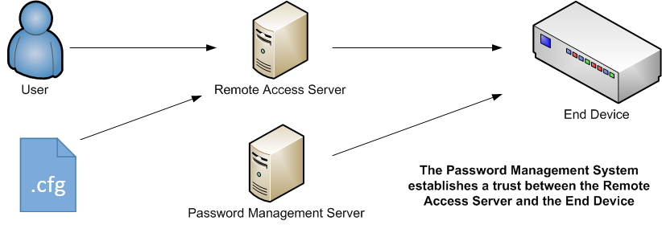
Using IEC 61850 for Enterprise Management
The Configuration Management, Password Management, and Remote Engineering Access Management need to be integrated.

Slide 27
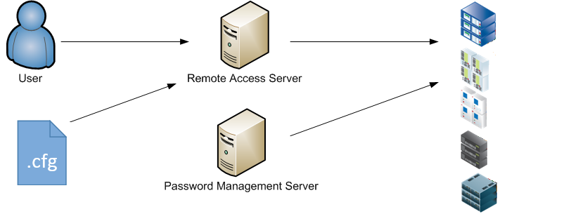
Integrated Solution using IEC 61850
The solution needs to be vendor-agnostic.

Slide 28
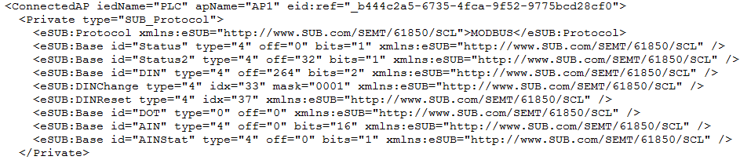
IEC 61850 SCL Files are Extensible
The CID schema can be extended for defining existing utility install base of IEDs
  DNP3
  Modbus, etc.
The CID schema can be extended to support equipment such as routers and switches as well.

Slide 29

Solving part of the problem
IEC-61850 SCL helps us with…
  considering all device configurations as one holistic substation configuration.
  differencing two different configuration files.
  Ensuring compatibility with legacy devices.
  considering the IT devices (routers, switches, and radios) the same at the OT devices.
  Leveraging open standards.

Slide 30
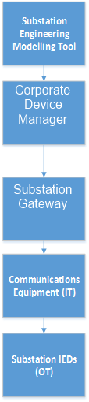
IEC 61850 SCL Implementation
SCD File is loaded into Corporate Device Manager for auto configuration at the Corporate level
Transfer SCD File to Substation Gateway for auto configuration at the Substation level
Active Configuration Monitoring of Substation IEDs and Communication Equipment

Slide 31
In Summary…
Integration solutions from device vendors benefit from Multi-vendor Interoperability issues as they maximize revenue when they sell their Single Vendor solution
However effective IEC 61850 Multi-Vendor Integration is possible
IEC-61850 Interoperability issues can be resolved when companies are focused on providing true Multi-vendor solutions
Ameen H. Hamdon, P.Eng.
SUBNET Solutions Inc.
hamdon@SUBNET.com
+1 403 270-8885

